Slide 1
Neural Information Retrieval

Slide 2




Slide 3
Outline
Vector representations
Pre-training methods in information retrieval

Slide 4

Slide 22

Slide 5
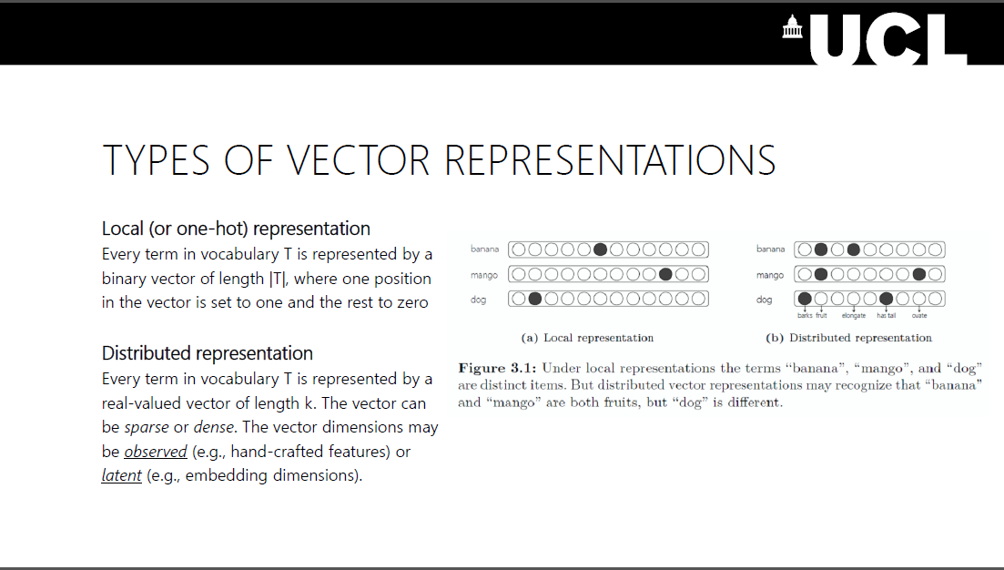
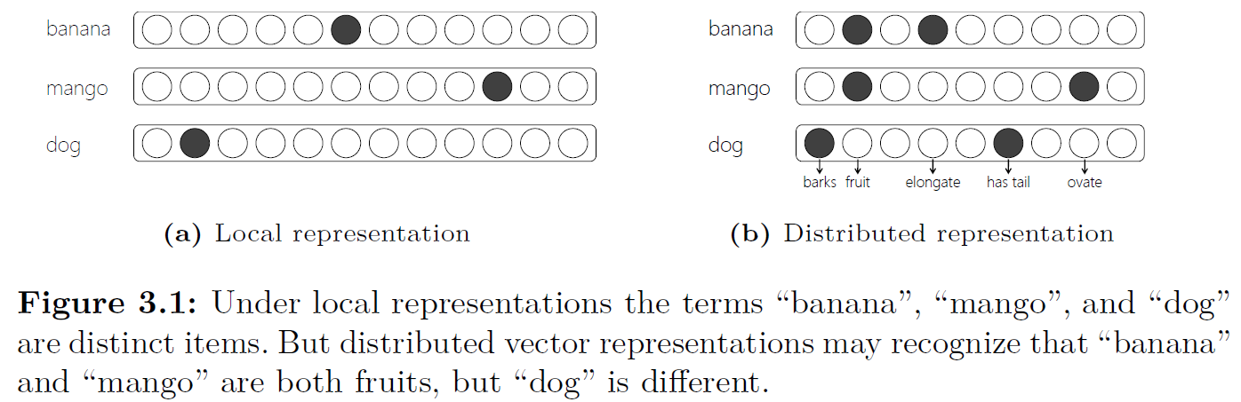

Slide 6
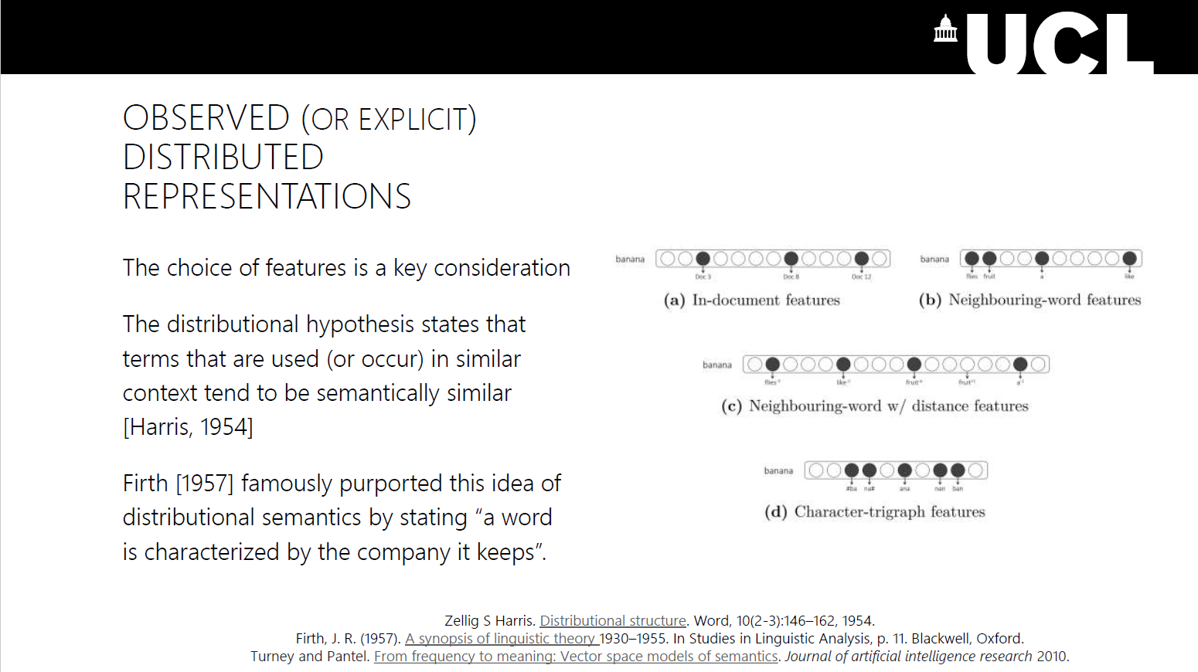
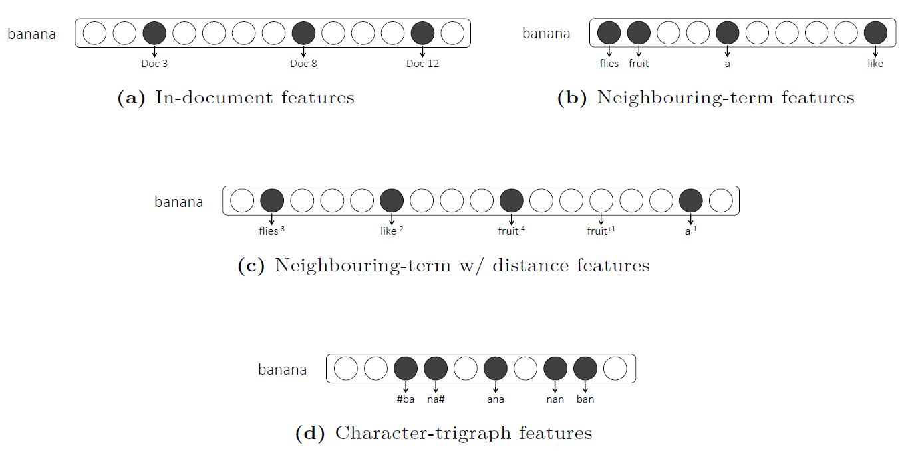
Slide 25

Slide 7
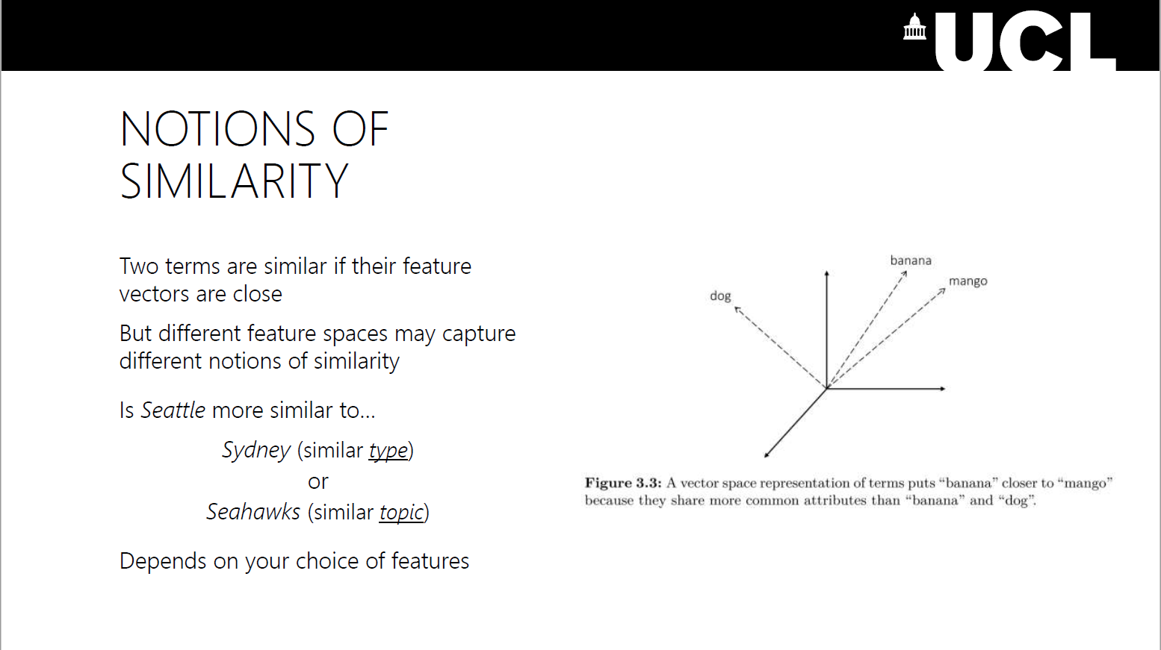
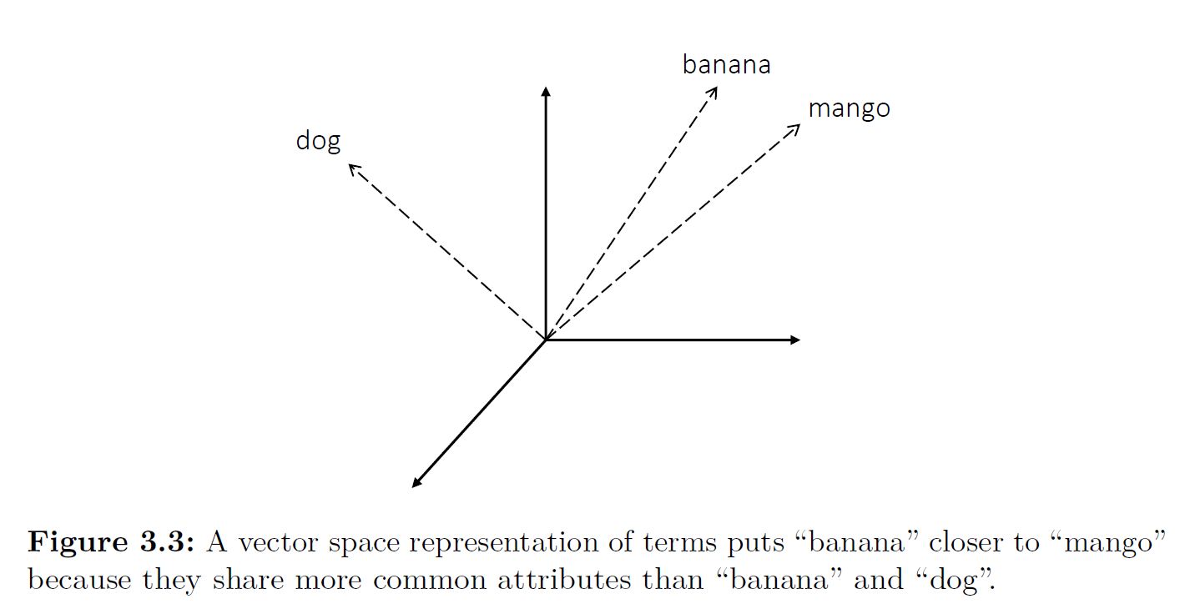
29

Slide 8
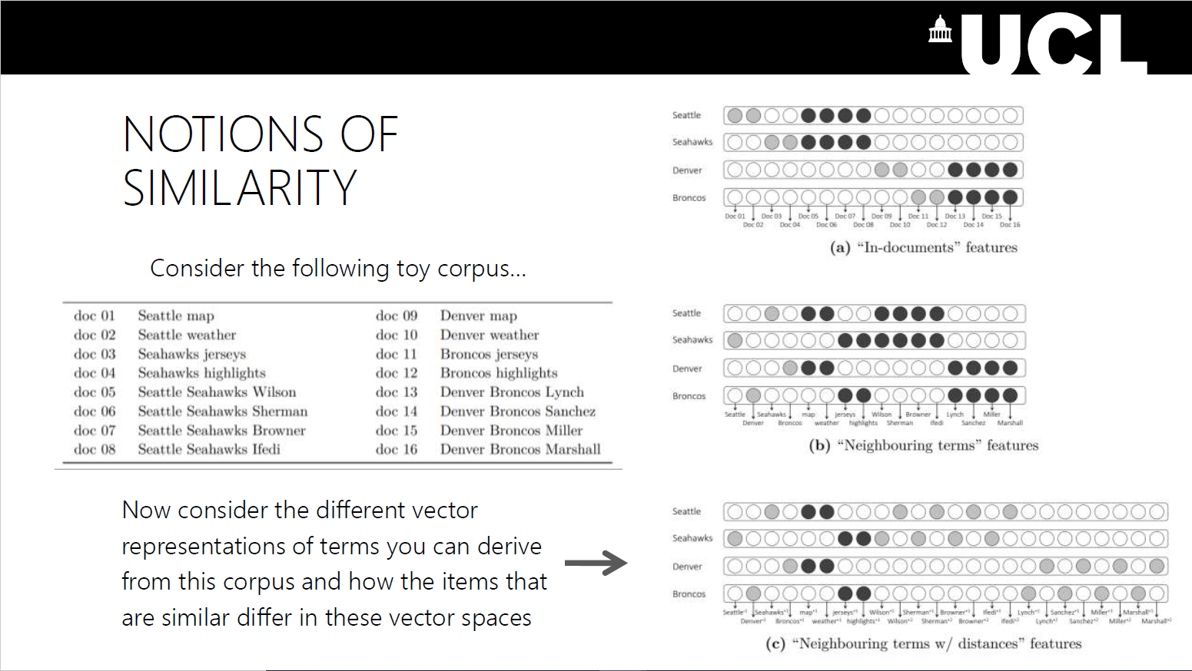
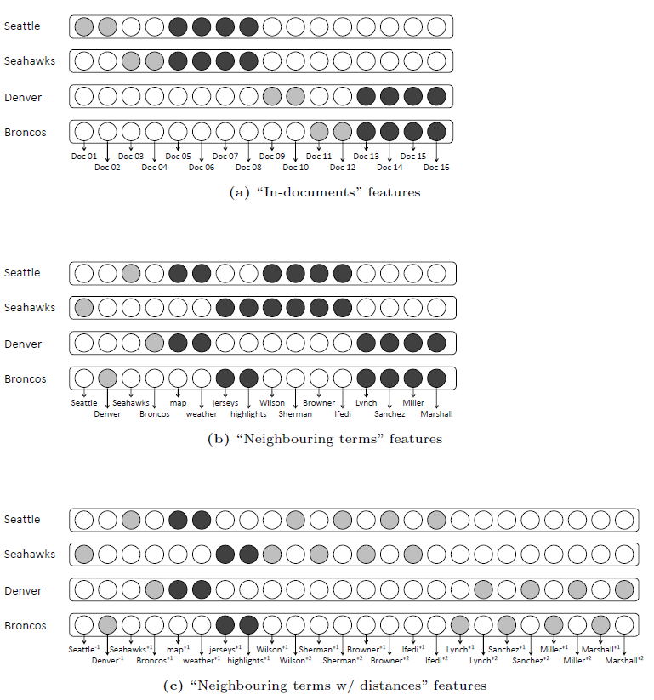
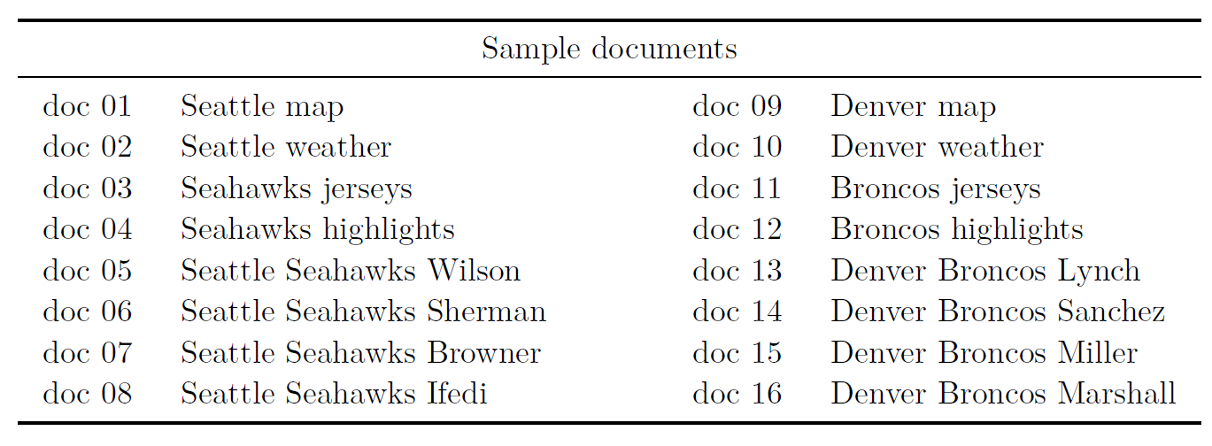
30

Slide 9
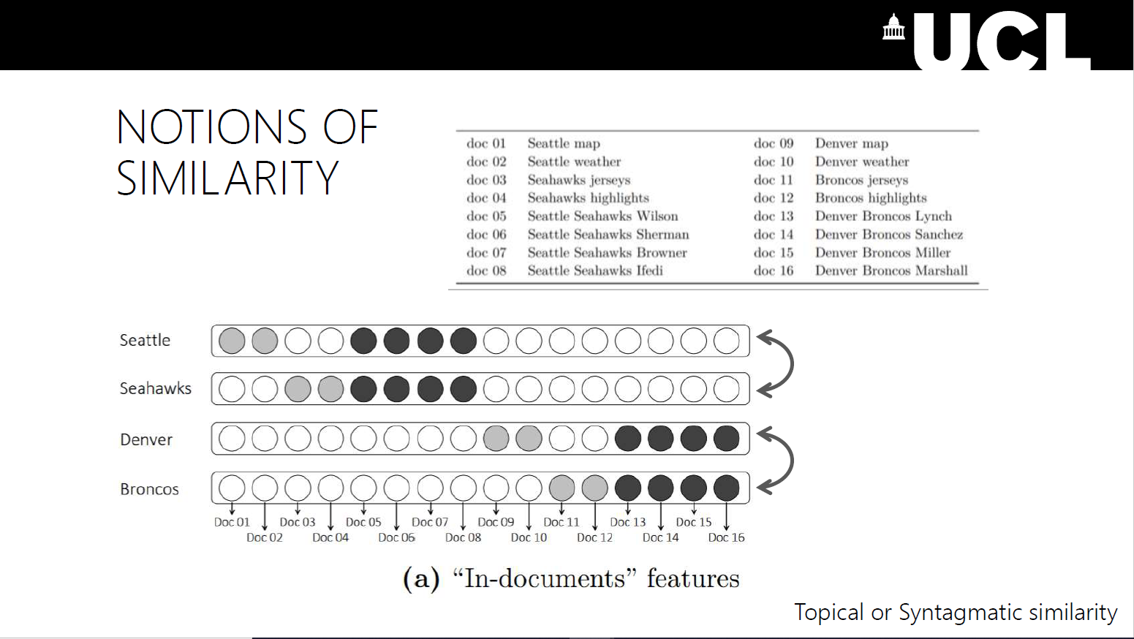
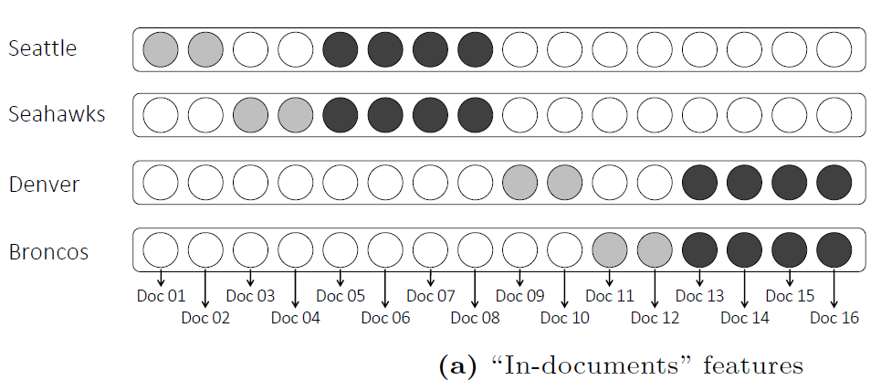

Slide 10
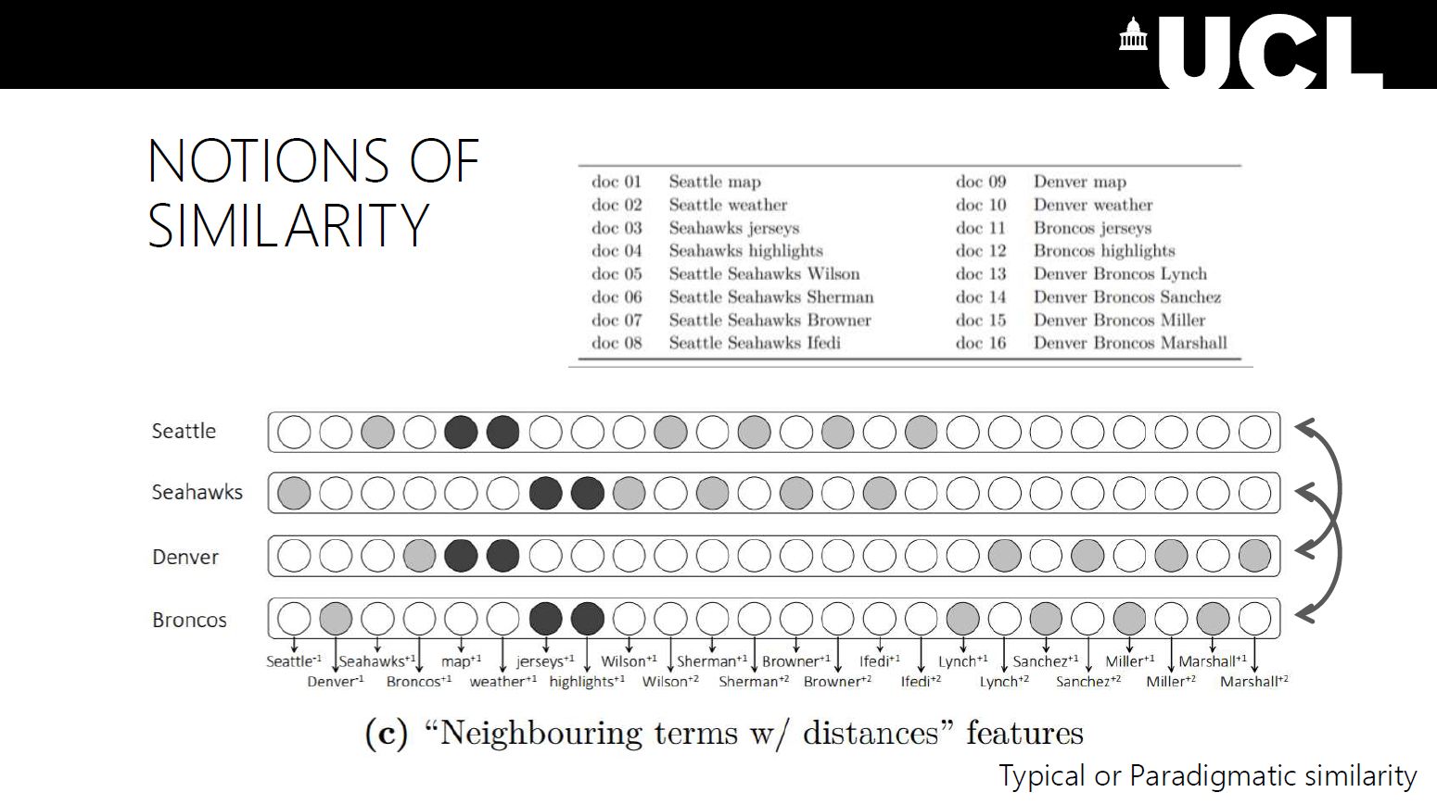

Slide 11
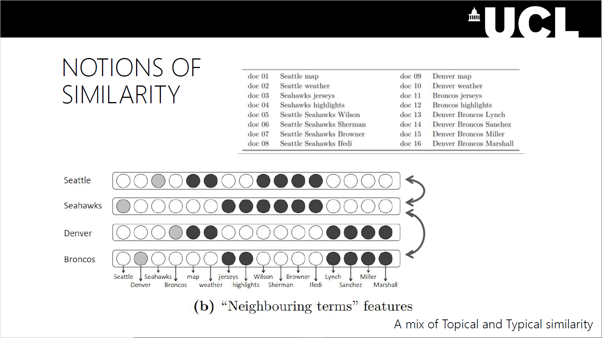

Slide 12
30

Slide 13
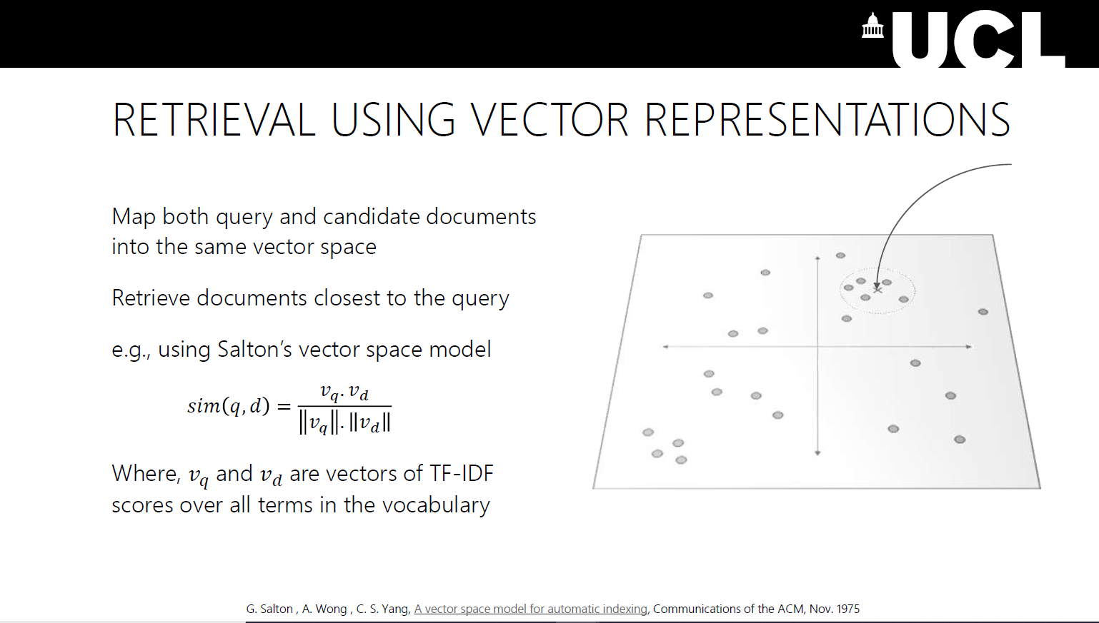
Slide 35

Slide 14
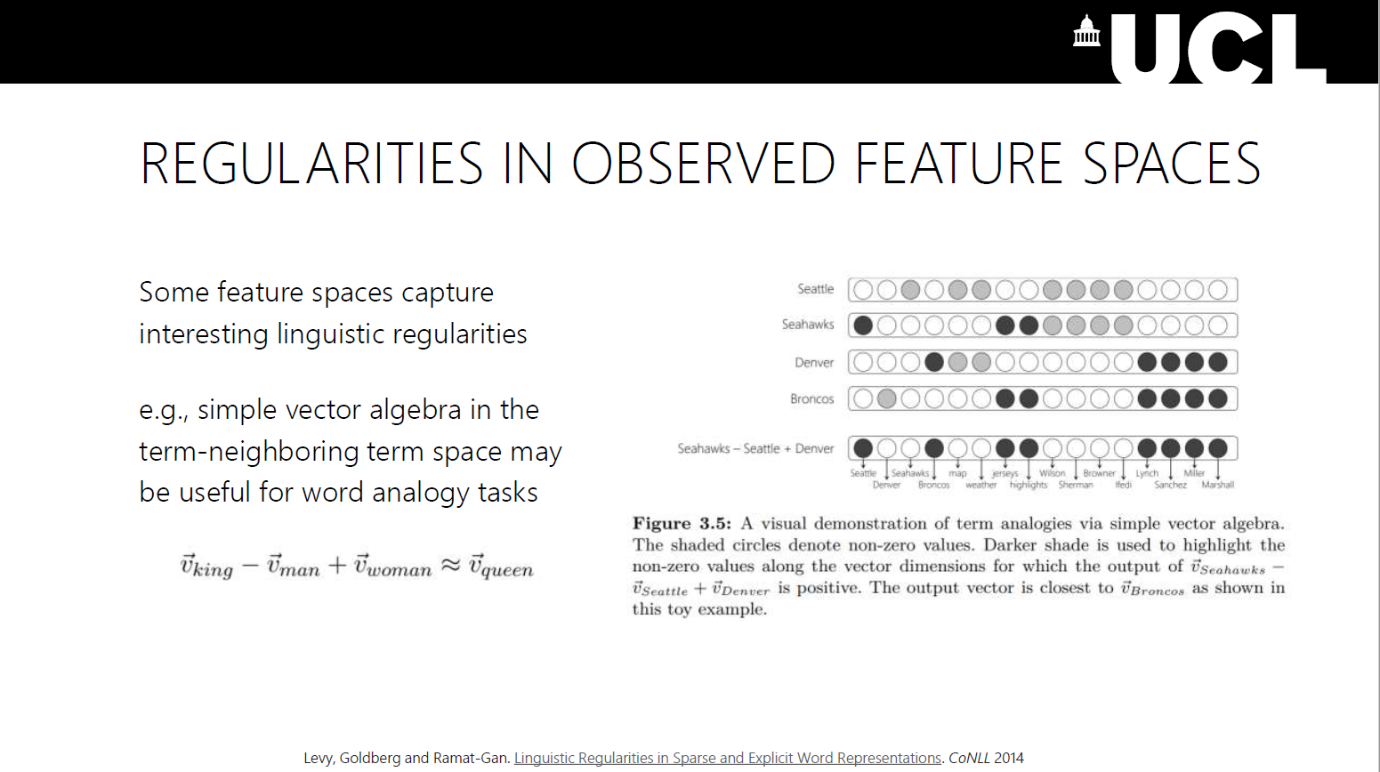
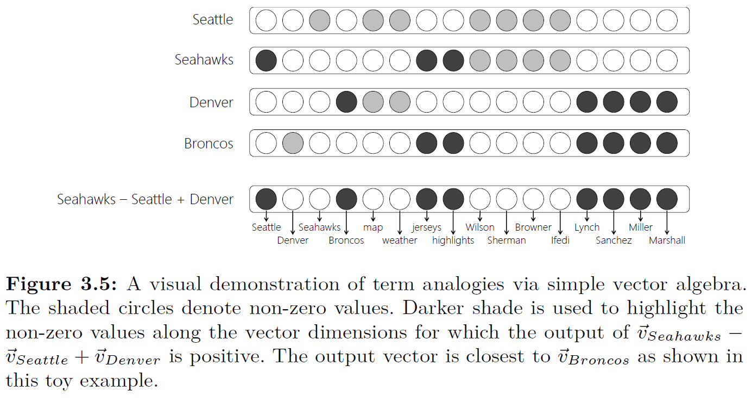
Slide 36

Slide 15
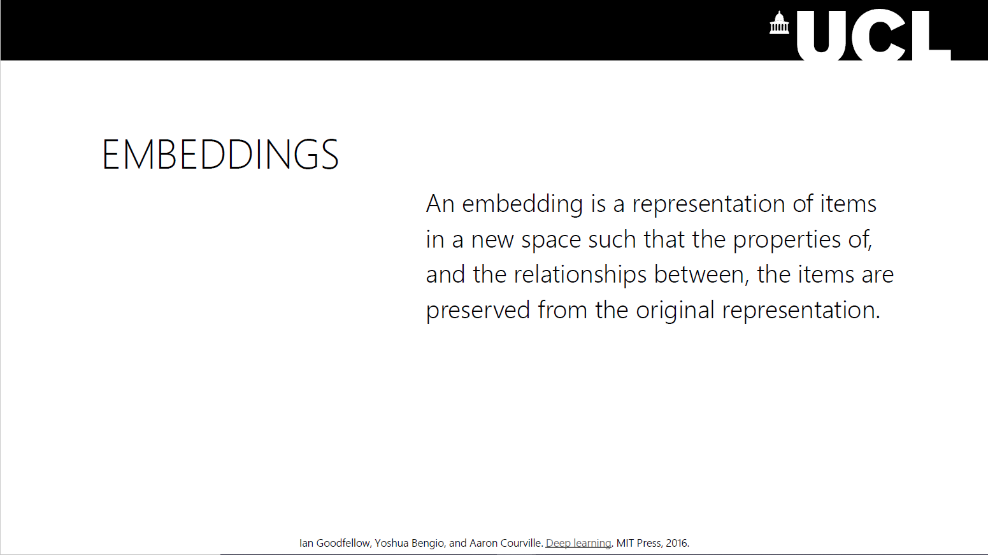
Slide 37

Slide 16
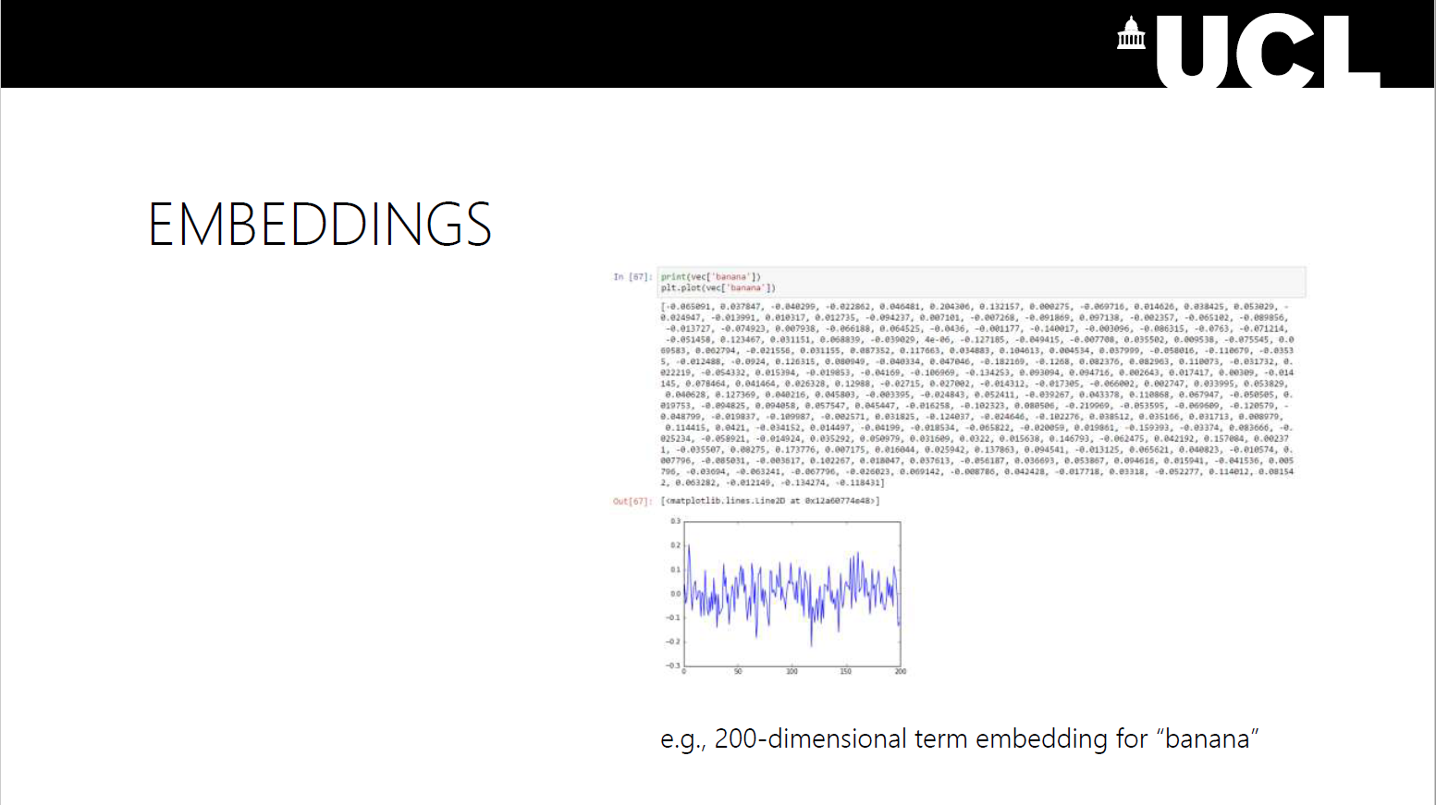
Slide 38

Slide 17
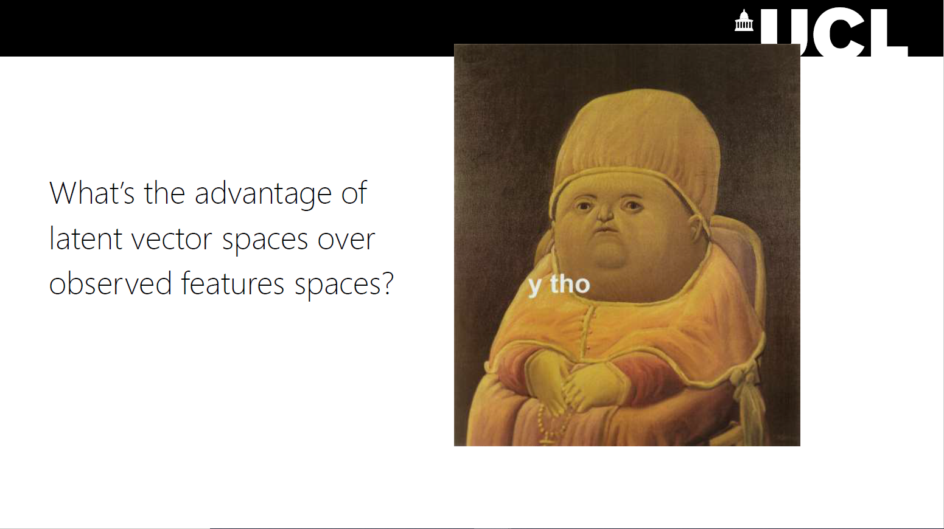
40

Slide 18
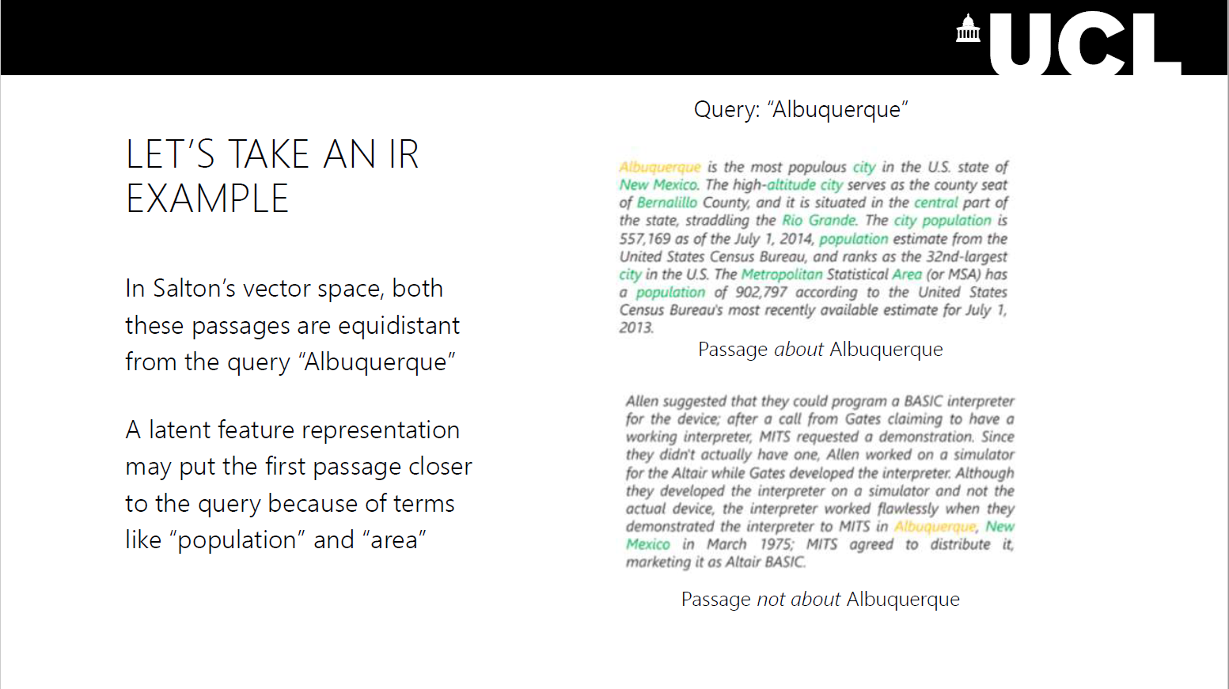
41

Slide 19
Embeddings
Context independent
There is just one vector representation for each word
Different senses of the word are combined into one single vector
Examples: Word2Vec, GloVe
Context dependent
Can have multiple vector representations for the same word based on the context
Examples: BERT, RoBERTA, XLNet

Slide 20
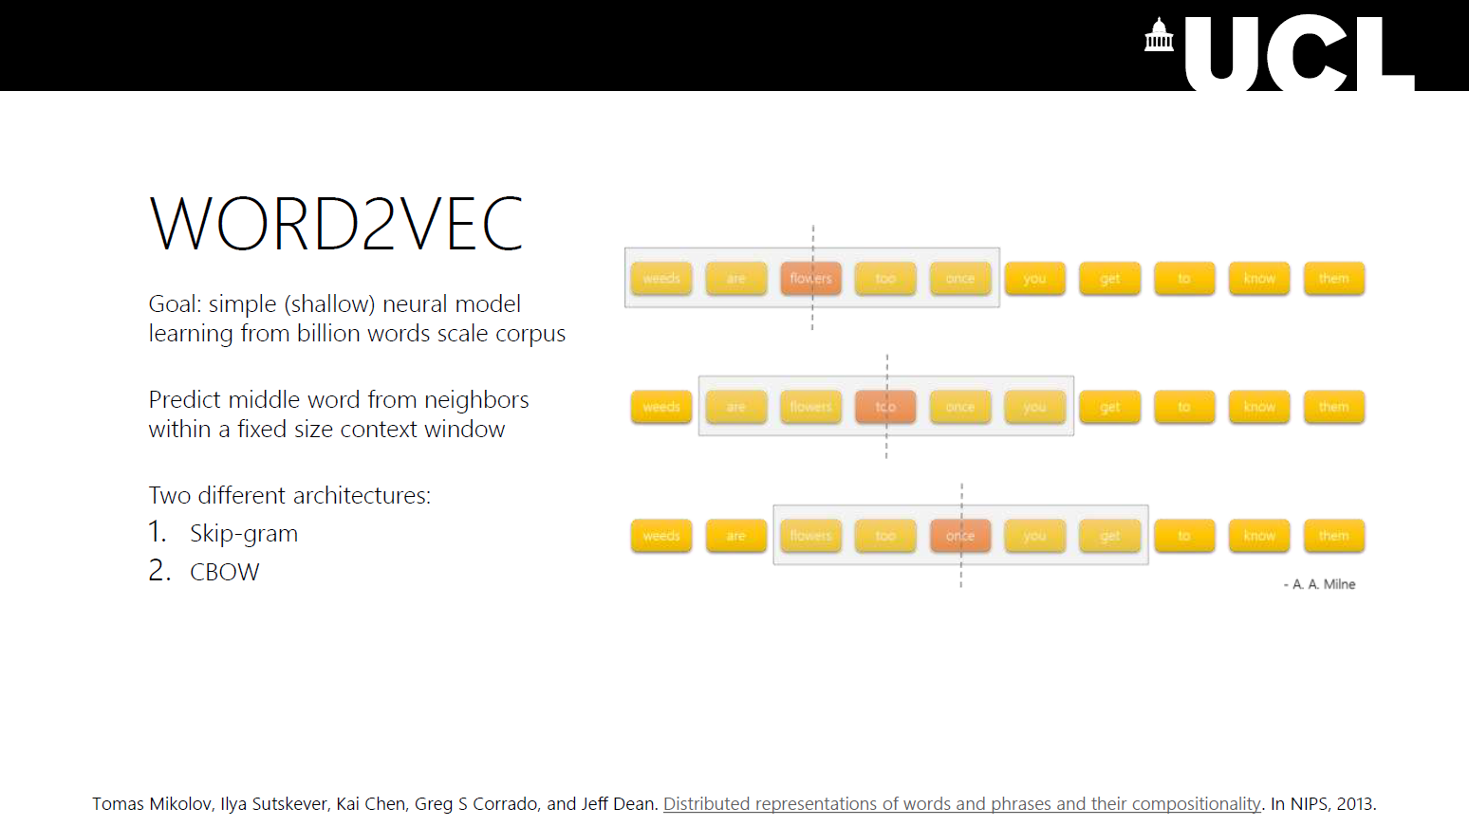
45

Slide 21
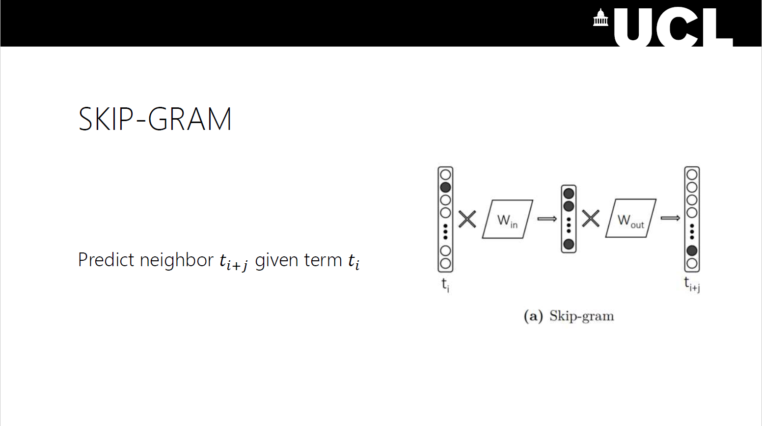
46

Slide 22
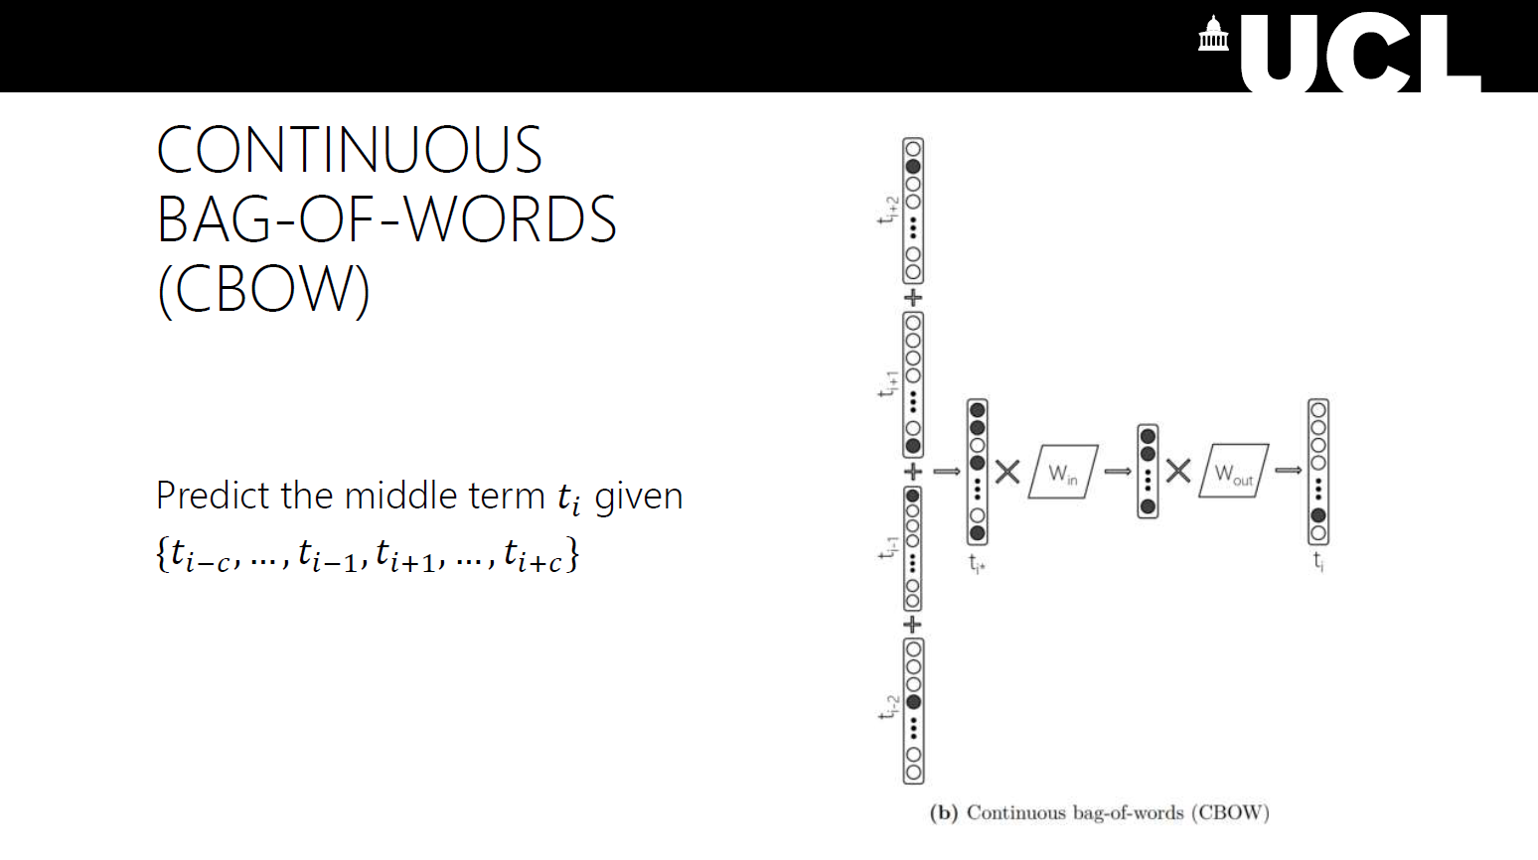
48

Slide 23
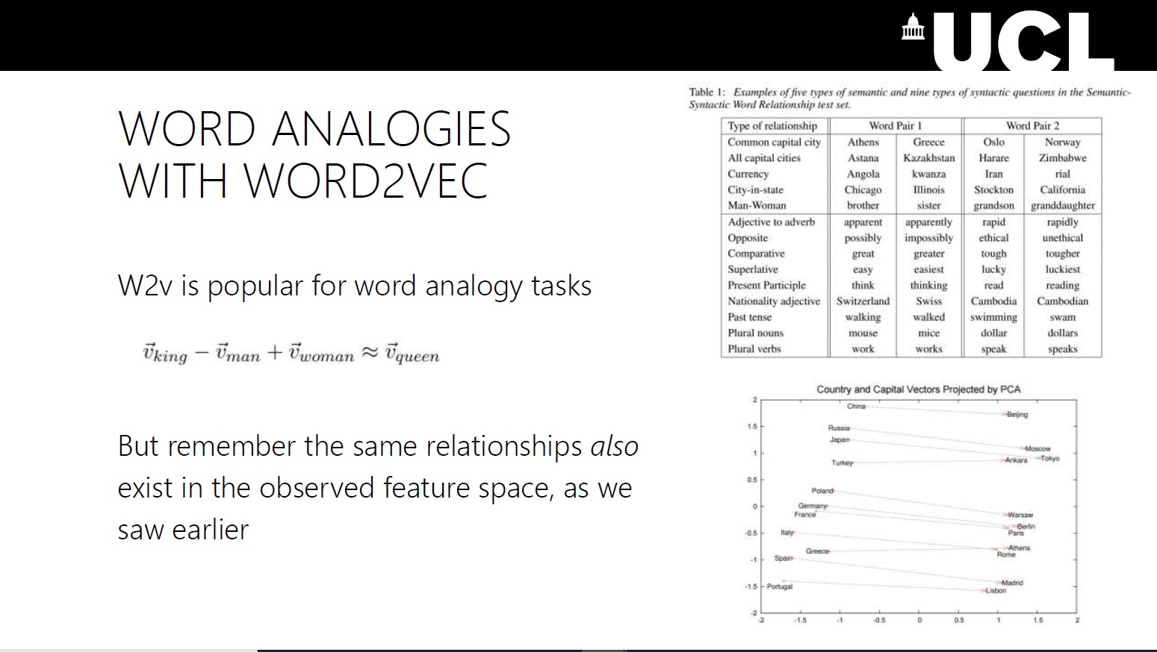
50

Slide 24
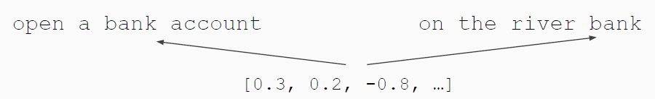
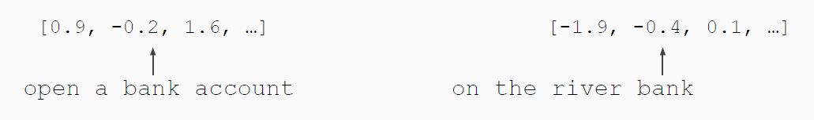
Contextual Representations
Problem: Word embeddings are applied in a context free manner
Solution: Train contextual representations on text corpora

Slide 25
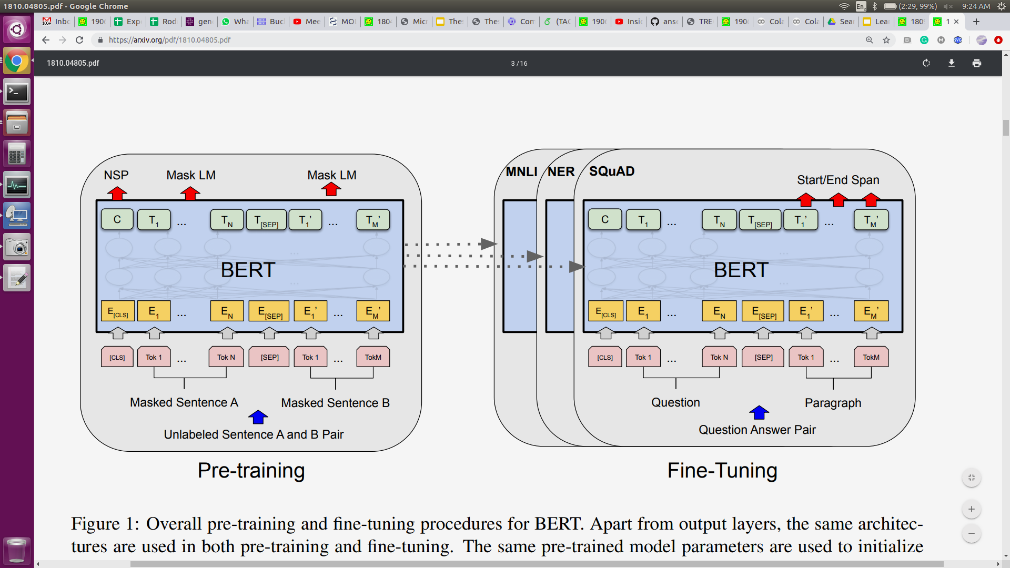
What is BERT?
Self-supervised: ∞ training data
Supervised: (few) labeled examples
Devlin, Chang, Lee, Toutanova. BERT: Pre-training of Deep Bidirectional Transformers for Language Understanding. NAACL 2019.

Slide 26
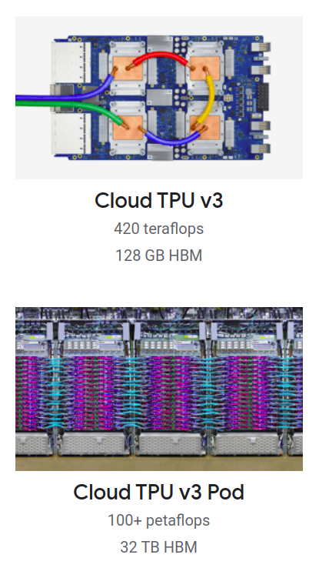
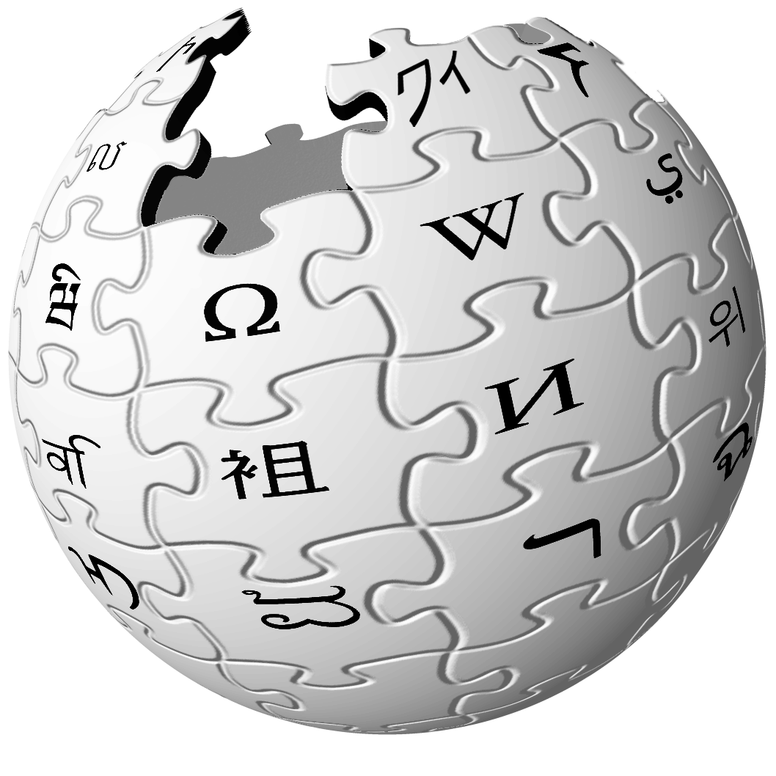
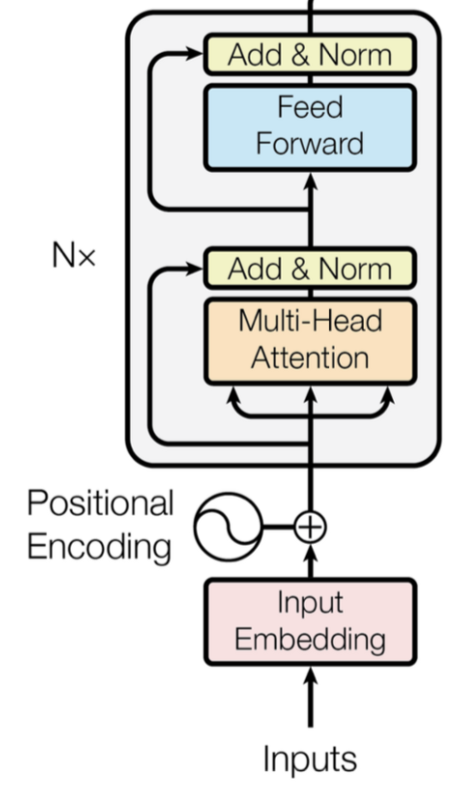

BERT's Pretraining Ingredients
+
+
Transformer (encoder-only)
with lots of parameters
Lots of texts
Lots of Compute

Slide 27
BERT
T_{[CLS]}
T₁
T₂
T₃
T₄
T₅
T₆
T₇
T_{[SEP]}
string → sequence of vectors
…
…
…
…
…
…
…
…
…
E_{[CLS]}
E₁
E₂
E₃
E₄
E₅
E₆
E₇
E_{[SEP]}
[CLS]
t₇
[SEP]
[CLS]
A₁
t₁
A₂
t₂
A₃
t₃
[SEP]
t₄
B₁
t₅
B₂
Token
Embeddings
t₆
+
+
+
+
+
+
+
+
+
Segment
Embeddings
E_{A}
E_{A}
E_{A}
E_{A}
E_{A}
E_{A}
E_{A}
E_{A}
E_{A}
+
+
+
+
+
+
+
+
+
Position
Embeddings
P₀
P₁
P₂
P₃
P₄
P₅
P₆
P₇
P₈
Tokens
[CLS]
The
bank
makes
loans
to
clients
.
[SEP]
String
The bank makes loans to clients.

Slide 28
Loss = -log (P("to" | masked input))
Pretraining - Masked Language Modeling
softmax
D ྾ V
T_{[CLS]}
T₁
T₂
T₃
T₄
T₅
T₆
T₇
T_{[SEP]}
…
…
…
…
…
…
…
…
…
E_{[CLS]}
E₁
E₂
E₃
E₄
E₅
E₆
E₇
E_{[SEP]}
[CLS]
t.
[SEP]
[CLS]
A₁
t_{The}
A₂
t_{bank}
A₃
t_{makes}
[SEP]
t_{loans}
B₁
t_{[MASK]}
B₂
Token
Embeddings
t_{clients}
+
+
+
+
+
+
+
+
+
Segment
Embeddings
E_{A}
E_{A}
E_{A}
E_{A}
E_{A}
E_{A}
E_{A}
E_{A}
E_{A}
+
+
+
+
+
+
+
+
+
Position
Embeddings
P₀
P₁
P₂
P₃
P₄
P₅
P₆
P₇
P₈
Random masking
The
bank
makes
loans
[MASK]
clients
.

Slide 29
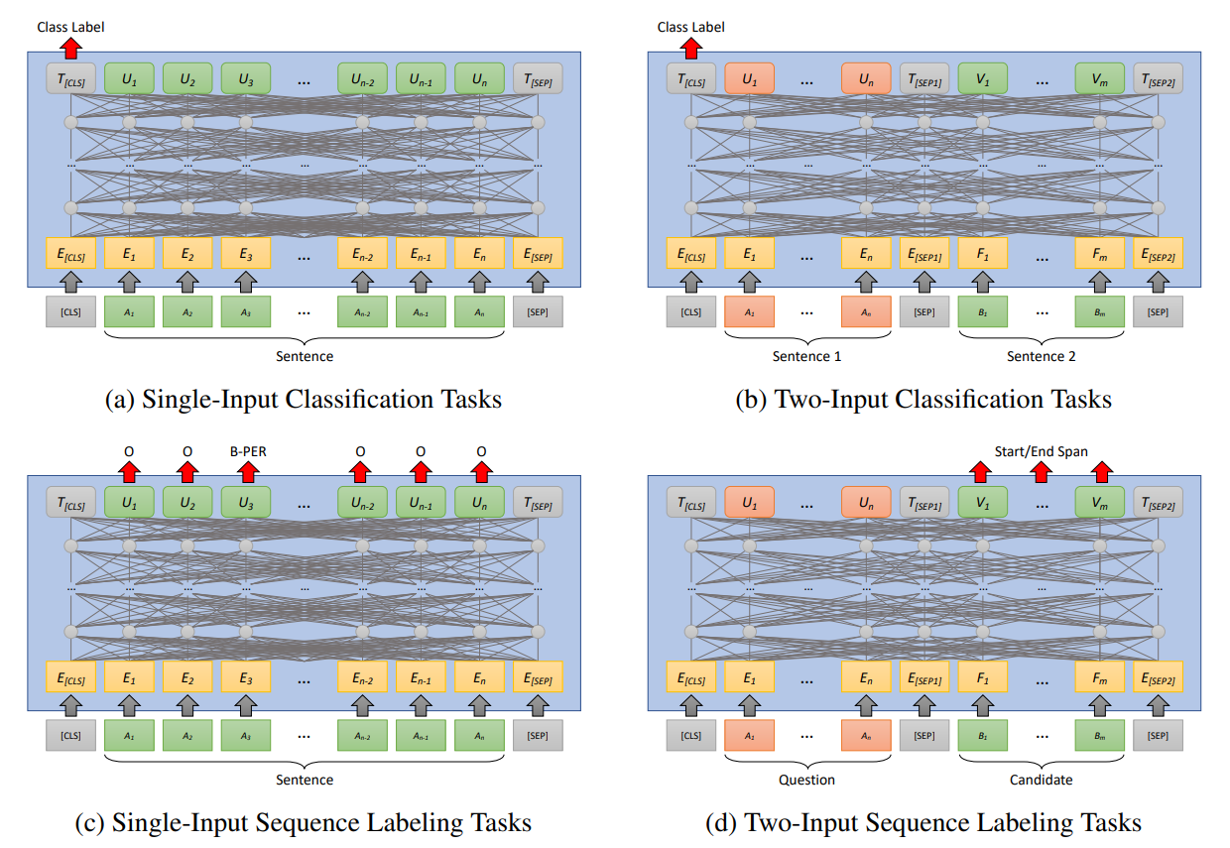
Finetuning

Slide 30
Post BERT Pretraining Advancements
RoBERTa: A Robustly Optimized BERT Pretraining Approach (Liu et al, University of Washington and Facebook, 2019)
XLNet: Generalized Autoregressive Pretraining for Language Understanding (Yang et al, CMU and Google, 2019)
ALBERT: A Lite BERT for Self-supervised Learning of Language Representations (Lan et al, Google and TTI Chicago, 2019)
T5:Exploring the Limits of Transfer Learning with a Unified Text-to-Text Transformer (Raffel et al, Google, 2019)
ELECTRA: Pre-training Text Encoders as Discriminators Rather Than Generators (Clark et al, 2020)
GPT2: Language Models are Unsupervised Multitask Learners (Radford et al, OpenAI, 2019)

Slide 31
PTMs in Information Retrieval
Pre-BERT models
BERT based models and more

Slide 32
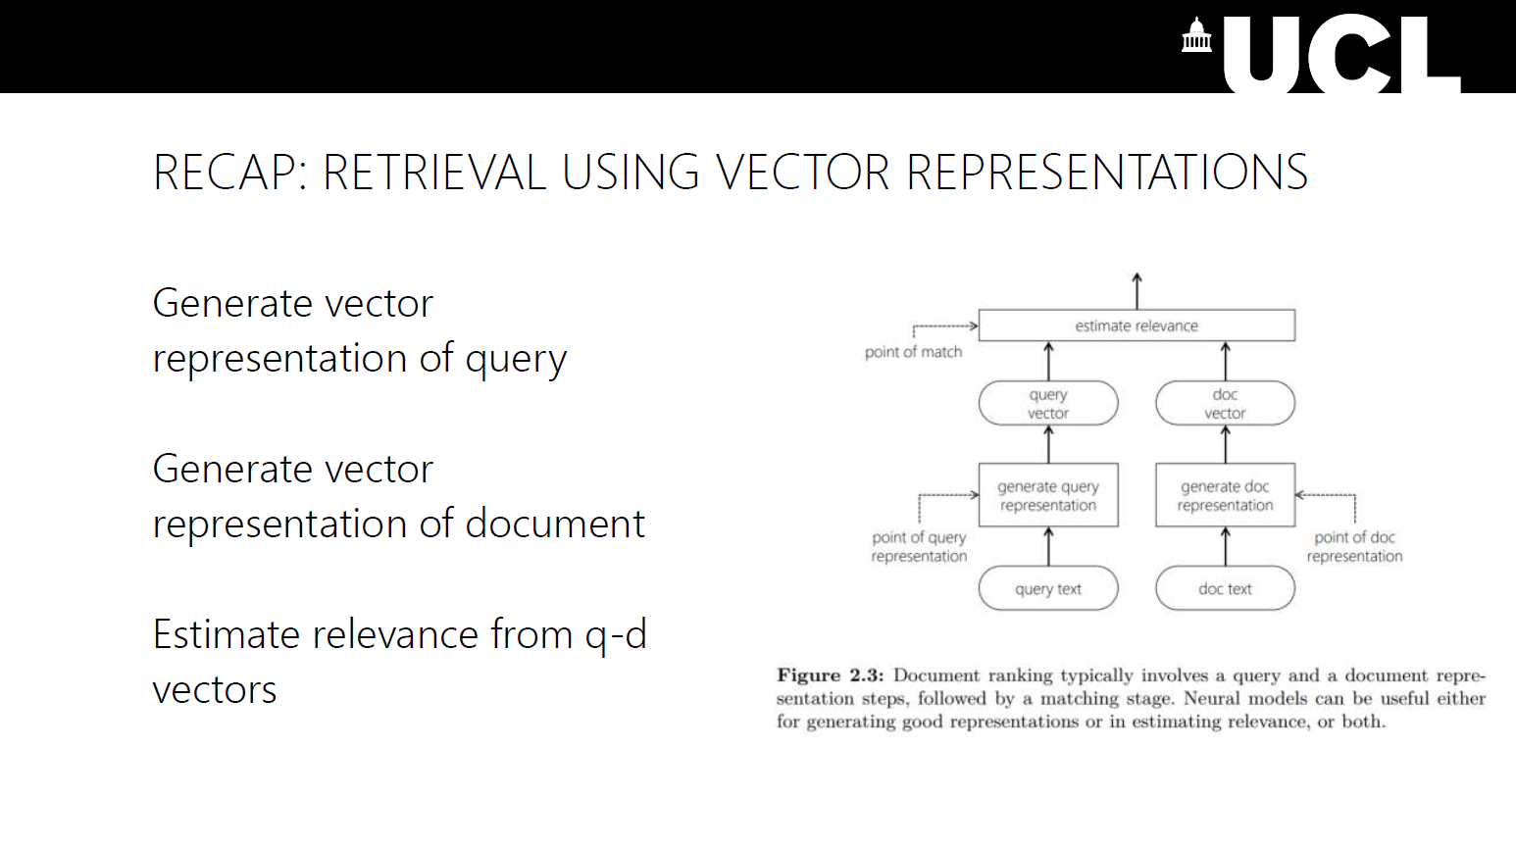
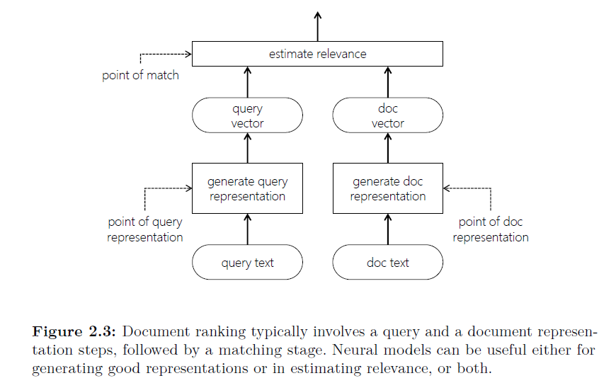
58

Slide 33
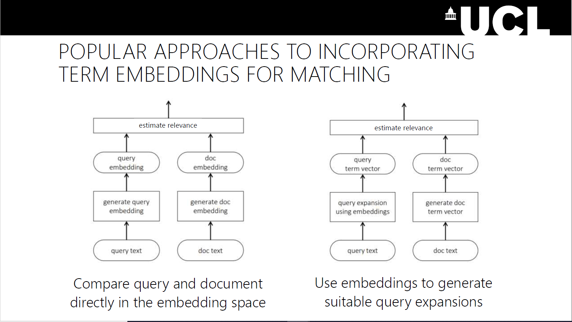
59

Slide 34
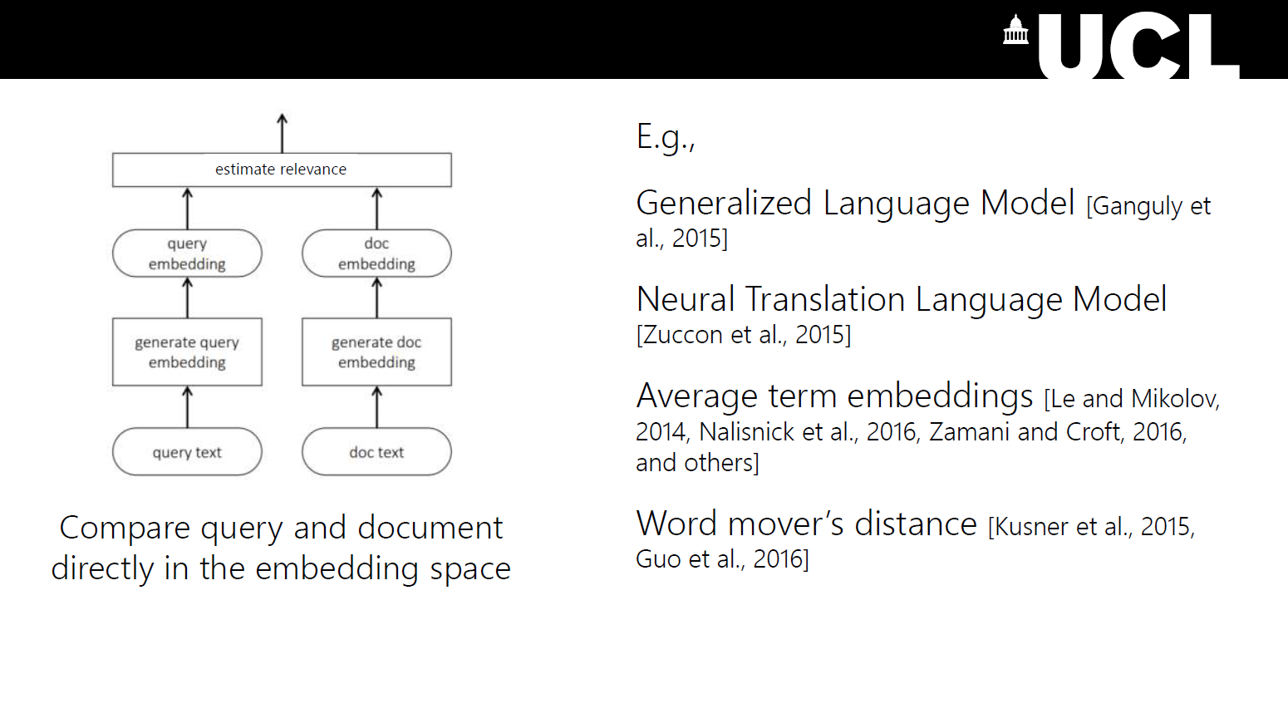
60

Slide 35
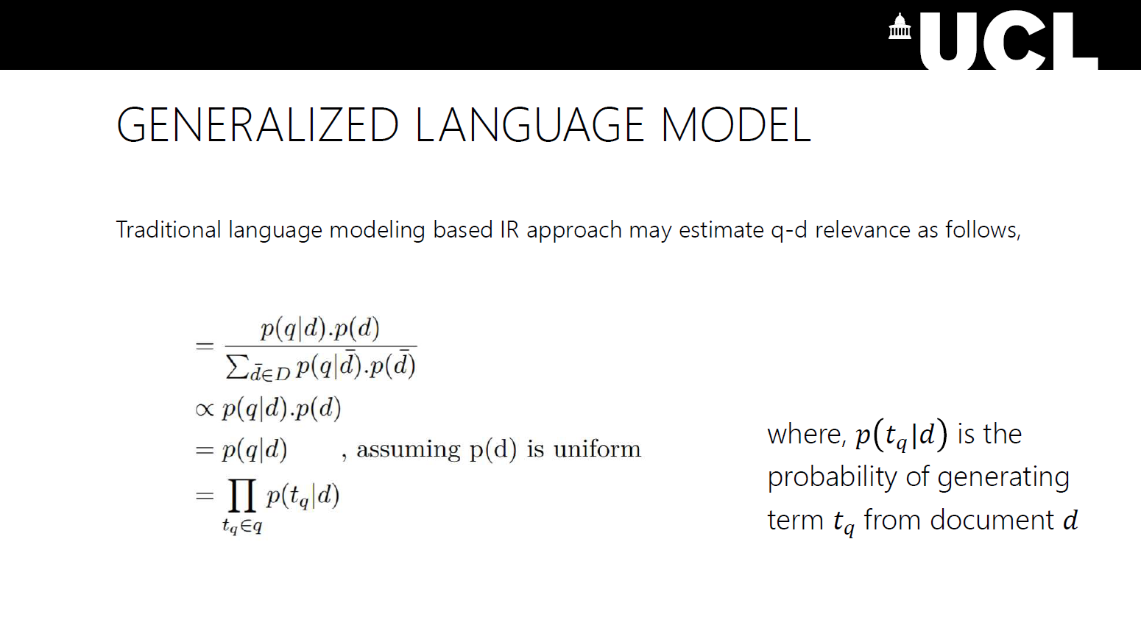
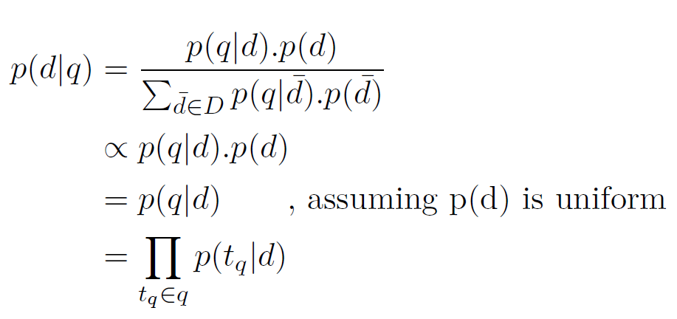
61

Slide 36
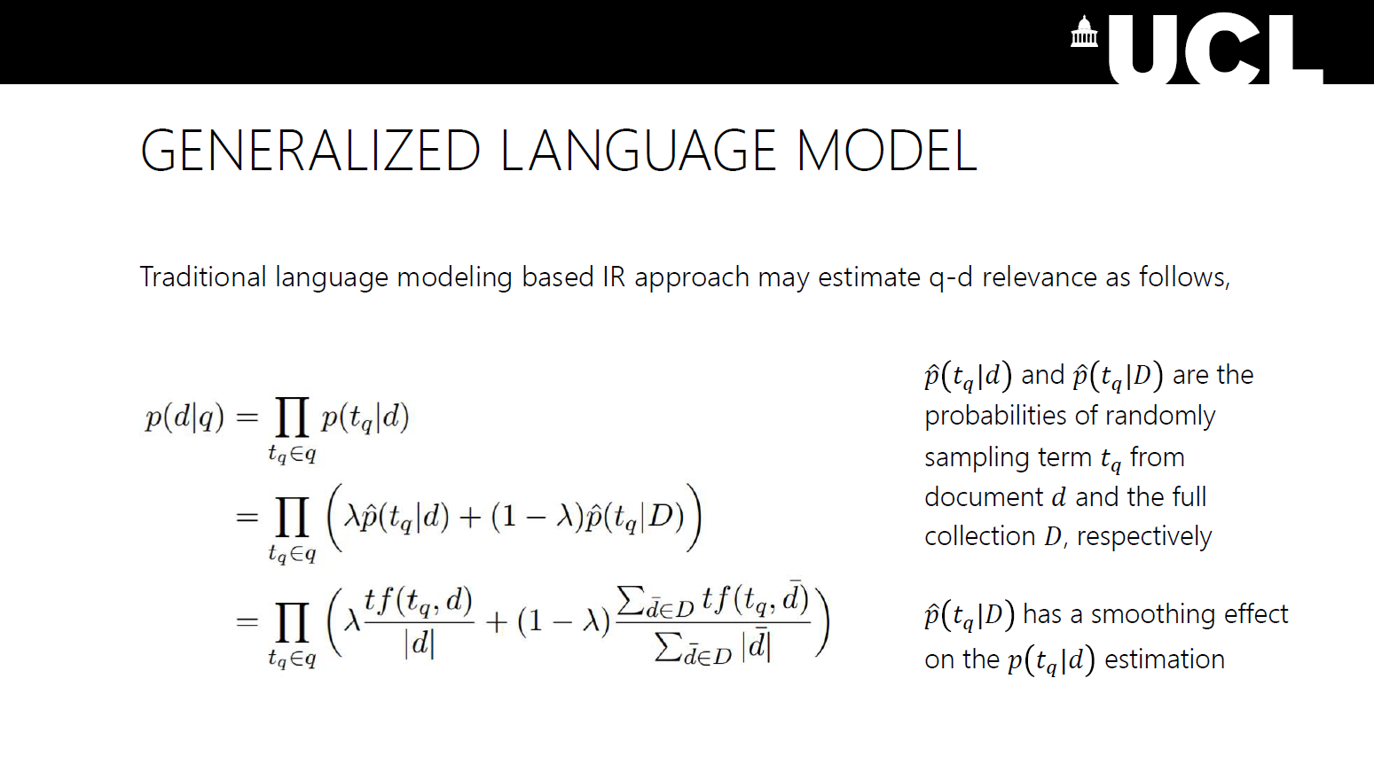
62

Slide 37
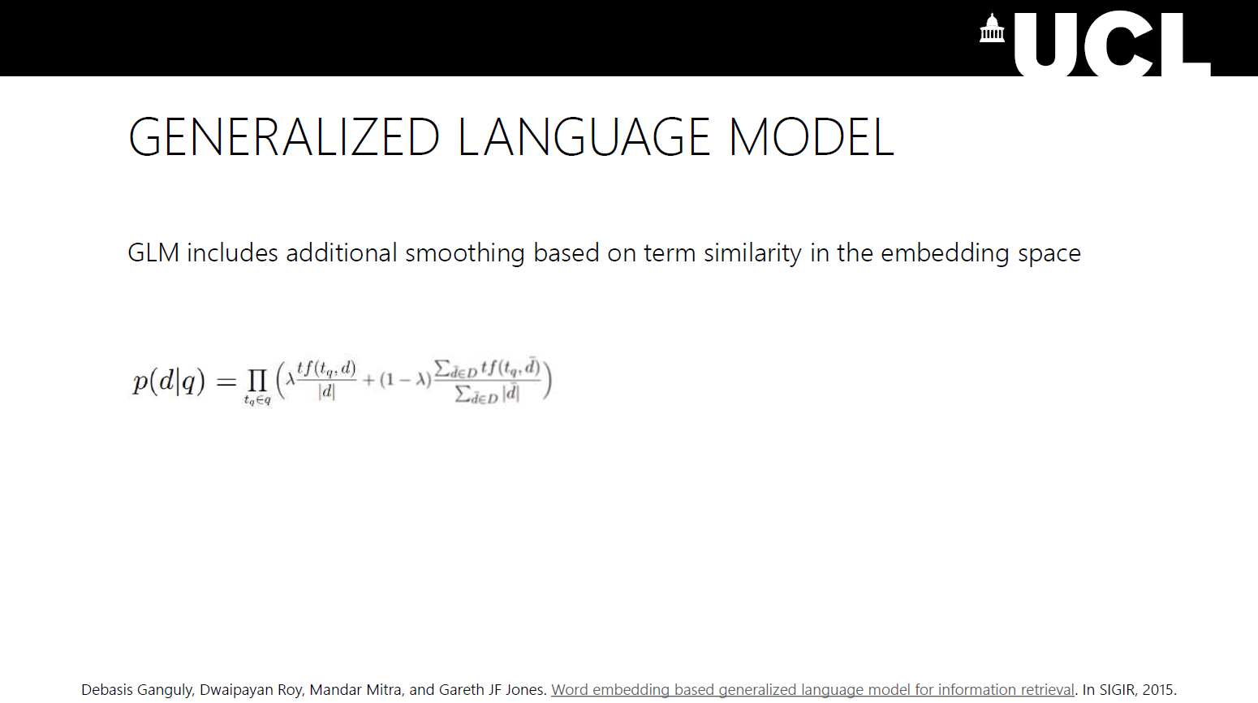
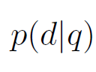
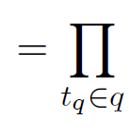
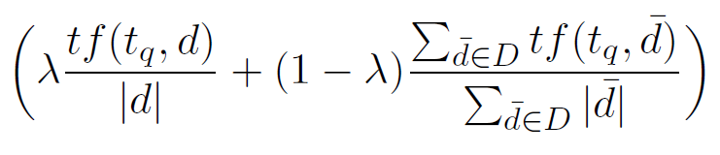
64

Slide 38
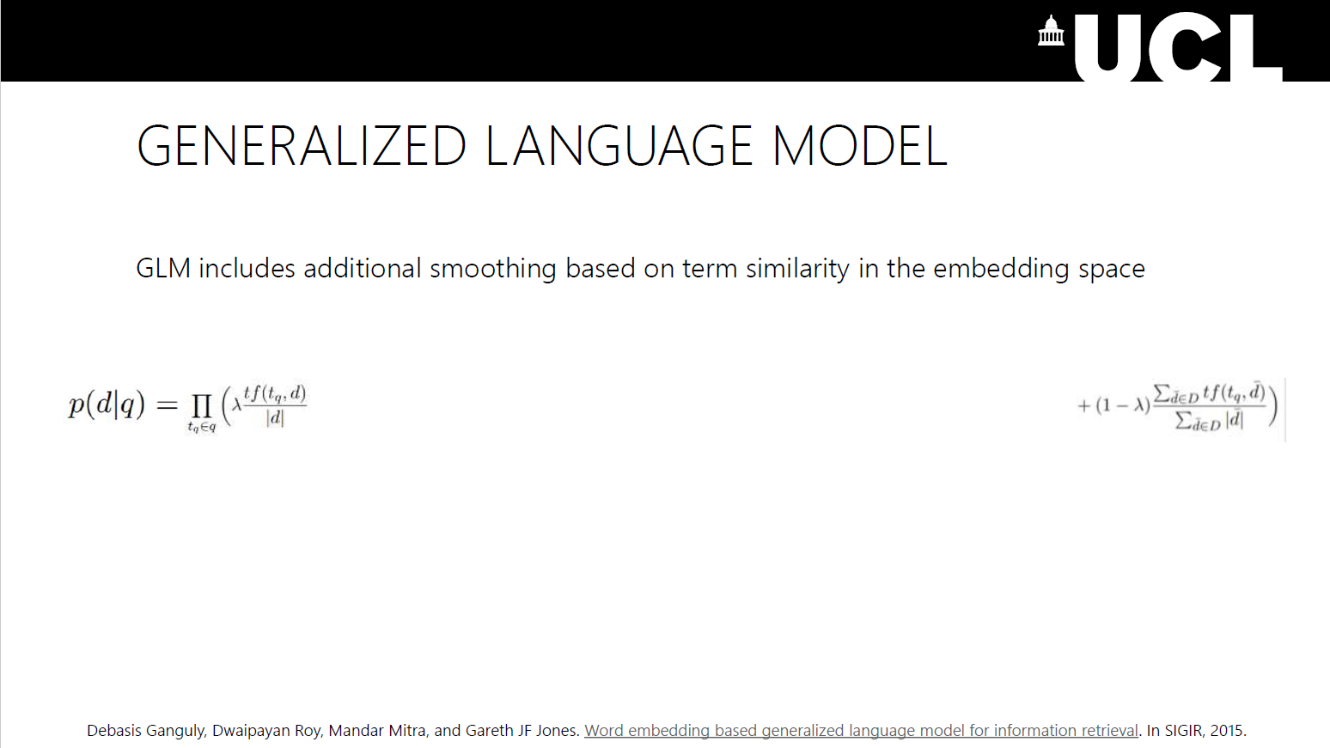
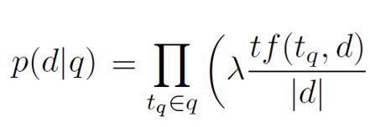
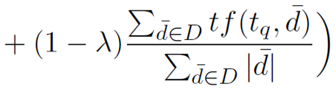
65

Slide 39
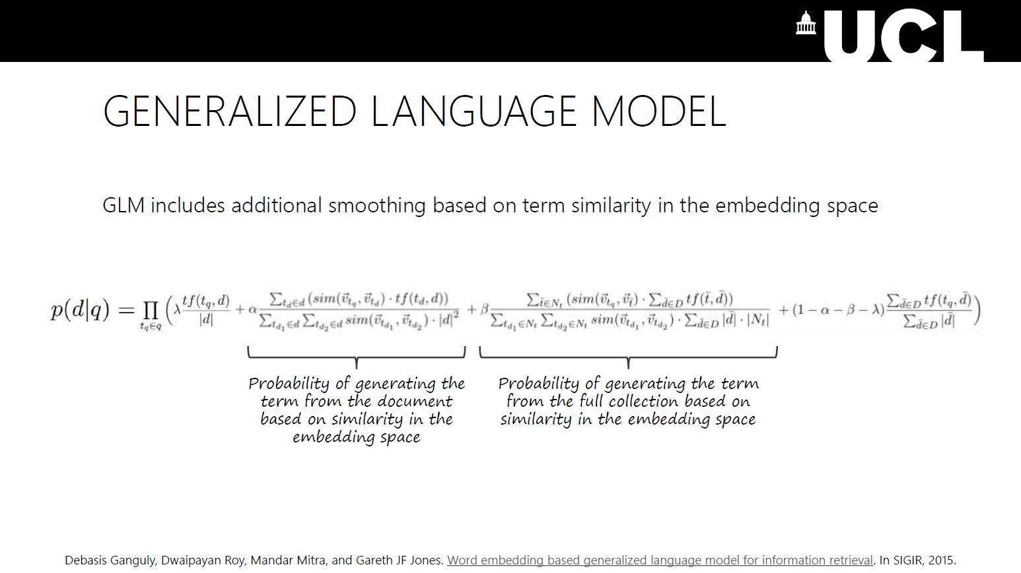
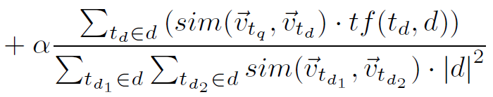
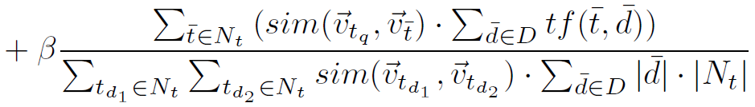
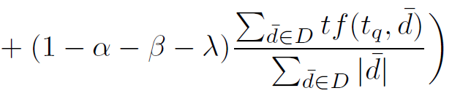
66

Slide 40
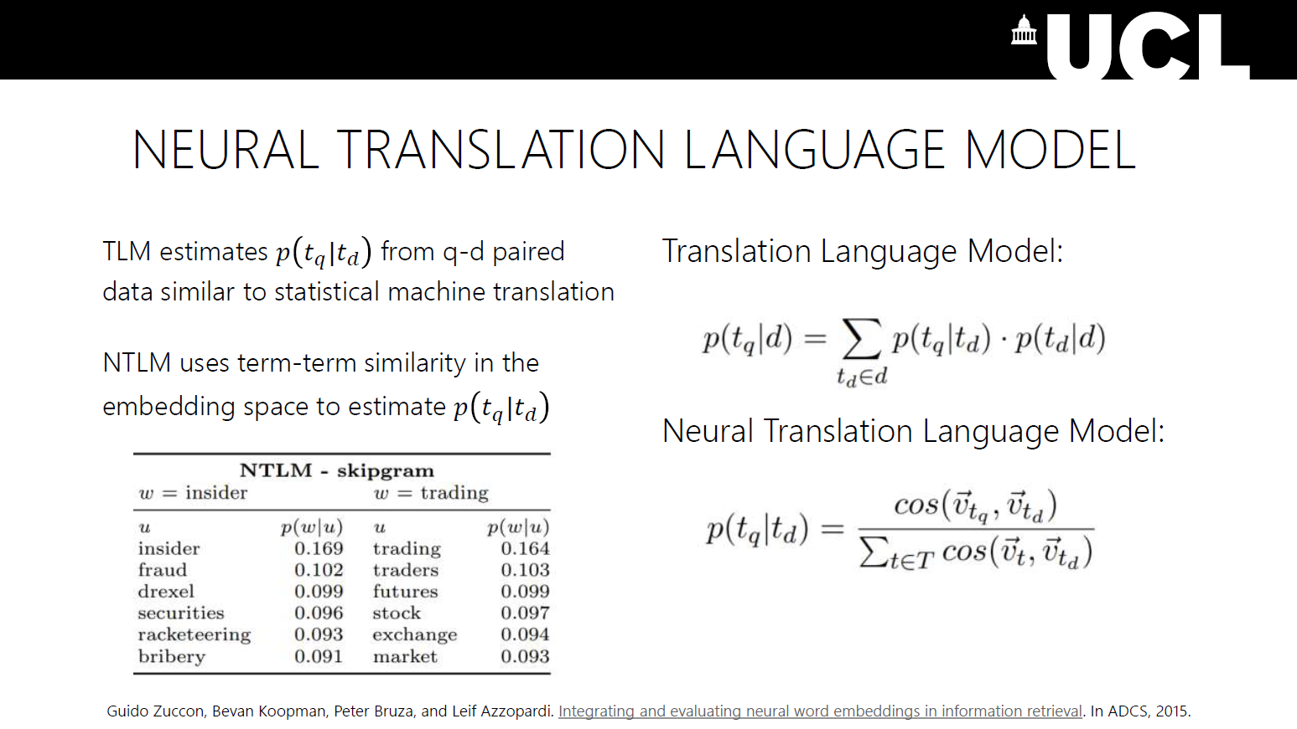
67

Slide 41

68

Slide 42

69

Slide 43

83

Slide 44

84

Slide 45

Progress in Information Retrieval - Robust04
Li et al., 2020;
Nogueira et al., 2020
Yilmaz et al., 2019; MacAvaney et al. 2019
Source: Yang et al., (2019)

Slide 46


Adoption by Commercial Search Engines
Google Search
MS Bing
We’re making a significant improvement to how we understand queries, representing the biggest leap forward in the past five years, and one of the biggest leaps forward in the history of Search.
Starting from April of this year (2019), we used large transformer models to deliver the largest quality improvements to our Bing customers in the past year.
source
source

Slide 47
BERT
for Relevance Classification
(aka monoBERT)

Slide 48

Retrieve-and-Rerank Architecture
e.g., BM25

Slide 49

monoBERT:
BERT reranker
Relevant
Non-relevant
s_{i} = softmax(T_{[CLS]}W + b)₁
We want:
s_{i} = P(Relevant = 1|q, d_{i})
softmax
D × 2
query q
text d_{i}

Slide 50



Training monoBERT
Loss:
Humans
BM25

Slide 51
Once monoBERT is trained...
H₀
R₀
H₁
R₁
q
BM25
d₁
monoBERT
d₅
d₂
d₂
Inverted Index
d₃
d₃
q
d₄
d₁
mono
BERT
s_{i}
d_{i}
d₅
d₄

Slide 52
TREC 2019 - Deep Learning Track - Passage
 | nDCG@10 | MAP | Recall@1k
BM25 | 0.506 | 0.377 | 0.739
monoBERT | 0.738 | 0.506 | 0.739
BM25 + RM3 | 0.518 | 0.427 | 0.788
monoBERT | 0.742 | 0.529 | 0.788

Slide 53
BERT’s Limitation
T_{[CLS]}
T₁
T₂
T₃
T₄
T₅
T₆
T₇
T_{[SEP]}
…
…
…
…
…
…
…
…
…
E_{[CLS]}
E₁
E₂
E₃
E₄
E₅
E₆
E₇
E_{[SEP]}
[CLS]
t₇
[SEP]
[CLS]
A₁
t₁
A₂
t₂
A₃
t₃
[SEP]
t₄
B₁
t₅
B₂
Token
Embeddings
t₆
Cannot input entire documents
what do we input?
& how do we label it?
+
+
+
+
+
+
+
+
+
Segment
Embeddings
E_{A}
E_{A}
E_{A}
E_{A}
E_{A}
E_{A}
E_{A}
E_{A}
E_{A}
+
+
+
+
+
+
+
+
+
Position
Embeddings
P₀
P₁
P₂
P₃
P₄
P₅
P₆
P₇
P₈
need separate embedding for every possible position
restricted to indices 0-511

Slide 54
From Passages to Documents

Slide 55



Handling Length Limitation: Training
Chunk documents
Transfer labels (approximation)

Slide 56
Handling Length Limitation: Inference
Aggregate Evidence

Slide 57
Approach #1: Score Aggregation
Document Score
Over passage scores. Dai, Callan. Deeper Text Understanding for IR with Contextual Neural Language Modeling. SIGIR 2019.
Over sentence scores. Yilmaz, Yang, Zhang, Lin. Cross-Domain Modeling of Sentence-Level Evidence for Document Retrieval. EMNLP '19.
s₁
s₂
s₃
…
…
…
…
…
…

Slide 58
Over Passage Scores: BERT-MaxP, FirstP, SumP
Document Score
s₁
s₂
s₃
Take max, first, or sum
…
…
…
…
…
…
Dai, Callan. Deeper Text Understanding for IR with Contextual Neural Language Modeling. SIGIR 2019.

Slide 59

Over Passage Scores: Results
Dai, Callan. Deeper Text Understanding for IR with Contextual Neural Language Modeling. SIGIR 2019.

Slide 60

Over Sentence Scores: Birch
First-stage retrieval score
Sentence scores
Trained on sentence-level judgments like tweets
Interpolation weights are tuned on target dataset
Yilmaz, Yang, Zhang, Lin. Cross-Domain Modeling of Sentence-Level Evidence for Document Retrieval. EMNLP '19.

Slide 61

Over Sentence Scores: Results
Yilmaz, Yang, Zhang, Lin. Cross-Domain Modeling of Sentence-Level Evidence for Document Retrieval. EMNLP '19.

Slide 62

Approach #2: Representation Aggregation
Over term embeddings. MacAvaney, Yates, Cohan, Goharian. CEDR: Contextualized Embeddings for Document Ranking. SIGIR 2019.
Over passage representations. Li, Yates, MacAvaney, He, Sun. PARADE: Passage Representation Aggregation for Document Reranking. arXiv 2020.
passage
representations

Slide 63

Over Term Embeddings: CEDR
similarity matrix using
contextualized embeddings (concatenate passages)
interaction-based pre-BERT
model (PACRR, KNRM)
MacAvaney, Yates, Cohan, Goharian. CEDR: Contextualized Embeddings for Document Ranking. SIGIR 2019.

Slide 64


Over Term Embeddings: CEDR
Relevant Document
Nonrelevant
MacAvaney, Yates, Cohan, Goharian. CEDR: Contextualized Embeddings for Document Ranking. SIGIR 2019.

Slide 65

Over Term Embeddings: Results
MacAvaney, Yates, Cohan, Goharian. CEDR: Contextualized Embeddings for Document Ranking. SIGIR 2019.

Slide 66

Over Passage Representations: PARADE
Aggregation approaches: (increasing complexity)
Average feature value
Max feature value
Attn-weighted average
Two Transformer layers
Aggregation of passages’ CLS embeddings
Li, Yates, MacAvaney, He, Sun. PARADE: Passage Representation Aggregation for Document Reranking. arXiv 2020.

Slide 67

Over Passage Representations: Results
Li, Yates, MacAvaney, He, Sun. PARADE: Passage Representation Aggregation for Document Reranking. arXiv 2020.

Slide 68
Multi-stage rerankers
why multi-stage?
duoBERT

Slide 69
Multi-stage rerankers
why multi-stage?
duoBERT

Slide 70

From Single to Multiple Rerankers

Slide 71

Why Multi-stage?
Trade-off between effectiveness (quality of the ranked lists) and efficiency (retrieval latency)
efficiency
effectiveness
Fewer Candidates

Slide 72
Multi-stage Rerankers
why multi-stage?
duoBERT

Slide 73
Multi-stage with duoBERT
H₀
R₀
H₁
R₁
H₂
R₂
q
BM25
d₁
monoBERT
d₅
duoBERT
d₃
d₂
d₂
d₅
Doc Pairwise
Inverted
Index
d₃
d₃
d₂
d₂
d₃
d₃
d₅
d₅
d₂
q
d₃
d₅
d₂
d₅
d₂
d₃
d₄
mono
BERT
s_{i}
q
d_{i}
d₅
d_{i}
duo
BERT
p_{i,j}
d_{j}
Nogueira, Yang, Cho, Lin. Multi-stage document ranking with bert. 2019.

Slide 74
duoBERT's Input Format
p_{i,j}
D ྾ 2
...
...
duoBERT
T_{[CLS]}
U₁
U₂
U₃
T_{[SEP1]}
V₁
V_{m}
T_{[SEP2]}
X₁
X_{n}
T_{[SEP3]}
...
...
E_{[CLS]}
E₁
E₂
E₃
E_{[SEP1]}
F₁
F_{m}
E_{[SEP2]}
G₁
G_{n}
E_{[SEP3]}
...
...
[CLS]
[SEP]
d₁^{j}
d₁^{j}
[SEP]
[CLS]
A₁
q₁
A₂
q₂
A₃
q₃
[SEP]
[SEP]
B₁
d₁^{i}
B₂
Token
Embeddings
d_{m}^{i}
+
+
+
+
+
+
...
+
+
+
...
+
+
Segment
Embeddings
E_{A}
E_{A}
E_{A}
E_{A}
E_{A}
E_{B}
E_{B}
E_{B}
E_{C}
E_{C}
E_{C}
+
+
+
+
+
+
...
+
+
+
...
+
+
Position
Embeddings
P₀
P₁
P₂
P₃
P₄
P₅
P_{m+4}
P_{m+5}
P_{m+6}
P_{m+n+5}
P_{m+n+6}
query
text d_{i}
text d_{j}

Slide 75

Training duoBERT
Loss:
Is doc d_{i} more relevant than doc d_{j} to the query q?
p_{i,j} = p(d_{i}>d_{j} | q)
duoBERT
CLS
Query q
SEP
text d_{i}
SEP
text d_{j}

Slide 76
Inference with duoBERT
R₁
Text Pairs
R₂
d₁
d₂
d₁
d₁
d₂
d₂
d₃
d₃
monoBERT
d₂
d₃
d₂
d₃
d₁
d₃
d₁
d₂
d₃
d₁
q
Pairwise aggregation:
s₁ = p_{1,2} + p_{1,3}
s₂ = p_{2,1} + p_{2,3}
s₃ = p_{3,1} + p_{3,2}
d₁
duo
BERT
p_{1,2} = p(d₁>d₂ | q)
d₂

Slide 77

monoBERT vs. duoBERT

Slide 78
Takeaways of Multi-stage Rerankers
Advantage:
more tuning knobs → more flexibility in effectiveness/efficiency tradeoff space
Disadvantage:
more tuning knobs → more complexity

Slide 79
Document Preprocessing Techniques
Query vs document expansion
doc2query
DeepCT
DeepImpact

Slide 80
A Simple Search Engine
This section

Slide 81

Query Reformulation (aka query expansion)
query: "Where can I buy a small car?"
Query Reformulator
reformulated query: "compact car sales store"
Search Engine
Better Retrieved Docs

Slide 82
Query reformulation as a translation task
Query Reformulator
Query Language
Document Language
Hard: Input has little information
Document Translator
Query Language
Document Language
Easier: Input has a lot of information

Slide 83
Document Preprocessing Techniques
Query vs document expansion
doc2query
DeepCT
DeepImpact

Slide 84

doc2query
Document
seq2seq Transformer
Query
Supervised training:
pairs of <query, relevant document>
Nogueira, Yang, Lin, Cho. Document expansion by query prediction. 2019.
Source: Vaswani et al., 2017

Slide 85
doc2query
In practice: 5-40 queries are sampled
with top-k or nucleus sampling
Input: Document
Output: Predicted Query
Researchers are finding that cinnamon reduces blood sugar levels naturally when taken daily...
doc2query
does cinnamon lower blood sugar?
+
Concatenate
Researchers are finding that cinnamon reduces blood sugar levels naturally when taken daily...
Expanded Document:
does cinnamon lower blood sugar?
Index
Better Retrieved Docs
User's Query
foods and supplements to lower blood sugar
Search Engine

Slide 86
Results
 | MARCO Passage (MRR@10) | TREC-DL 19 (nDCG@10)
BM25 | 0.184 | 0.506
+ doc2query | 0.277 | 0.642
BM25 + RM3 | 0.156 | 0.518
+ doc2query | 0.214 | 0.655
BM25 + monoBERT/T5* | 0.365 | 0.738
+ doc2query | 0.379 | 0.754

Slide 87
Document Preprocessing Techniques
Query vs document expansion
doc2query
DeepCT
DeepImpact

Slide 88

DeepCT
Target Scores
0.0 1.0 1.0 0.0 0.0 0.0 0.0 0.0 0.0 0.0 0.0
Predicted Scores
0.2 0.5 0.2 0.1 0.4 0.1 0.0 0.6 0.2 0.4 0.3
D × 1
D × 1
...
D × 1
DeepCT (BERT)
Text d:
The Geocentric Theory was proposed by the greeks under the guidance...
Relevant query q: "who proposed the geocentric theory"
Dai, Callan. Context-aware sentence/passage term importance estimation for first stage retrieval. 2019.

Slide 89
Once DeepCT is trained...
Index
New document: "Researchers Researchers … finding finding … that that … cinnamon cinnamon ... reduces ... "
Term Frequencies:
10 0 20 10 90 80 90 100 40 20 0 10 40
Predicted Scores
0.1 0.0 0.2 0.1 0.9 0.8 0.9 1.0 0.4 0.2 0.0 0.1 0.4
D × 1
D × 1
...
D × 1
DeepCT (BERT)
Text d:
Researchers are finding that cinnamon reduces blood sugar levels naturally when taken daily...

Slide 90
Results on MS MARCO Passage Dev Set
Model | MRR@10 | R@1000 | BERT Inferences per doc
BM25 | 0.184 | 0.853 | -
+ doc2query | 0.229 | 0.907 | 1
+ doc2query | 0.277 | 0.944 | 40
DeepCT | 0.243 | 0.913 | 1

Slide 91
Document Preprocessing Techniques
Query vs document expansion
doc2query
DeepCT
DeepImpact

Slide 92
DeepImpact: combining doc2query with DeepCT
Output: Predicted Query
Researchers are finding that cinnamon reduces blood sugar levels naturally when taken daily...
Input Document
doc2query
does cinnamon lower blood sugar?
+
Concatenate
Researchers are finding that cinnamon reduces blood sugar levels naturally when taken daily...
Expanded Document:
does cinnamon lower blood sugar?
Term Scorer (~DeepCT)
{Researchers: 31, are: 0, finding: 4, that: 1, ...}
Index
Better Retrieved Docs
User's Query
foods and supplements to lower blood sugar
Search Engine
Mallia, Khattab, Tonellotto, and Suel. Learning Passage Impacts for Inverted Indexes. 2021

Slide 93
Results on MS MARCO Passage Dev Set
Model | MRR@10 | R@1000 | Latency (ms/query)
BM25 | 0.184 | 0.853 | 13
DeepCT | 0.243 | 0.913 | 11
doc2query | 0.278 | 0.947 | 12
DeepImpact | 0.326 | 0.948 | 58
BM25 + monoBERT | 0.355 | 0.853 | (GPU) 10,700

Slide 94
How to Expand Long Documents?
windows of N sentences
doc2query
DeepCT
DeepImpact
Queries or
Terms
doc2query
DeepCT
DeepImpact
Queries or
Terms
+
doc2query
DeepCT
DeepImpact
Queries or
Terms
doc2query
DeepCT
DeepImpact
Queries or
Terms

Slide 95
Takeaways of Document Expansion
Advantages:
Documents have more context than queries →easy prediction task
Documents can be processed offline and in parallel
Run on CPU at query time
Disadvantages:
Have to iterate over the entire collection
Not as effective as rerankers (yet)

Slide 96
Resources of Pre-training Methods in IR
Popular data repositories for the pre-training and fine-tuning process of PTMs in IR

Slide 97
Datasets for Pre-Training
Pre-training objectives for IR are mostly based on large-scale collections
Collections for pre-training tasks in IR must have the following properties:
Large collection size:
A necessity for pre-training tasks in any deep learning fields
Structured documents:
Title, passages, sub-title, html structure, etc. can be exploited to capture inter-page semantic relations
Hyperlinks between the pages provide intra-page semantic relations
The second property is not always necessary for IR pre-training tasks
But if a collection owns these properties, the collection might be better for IR pre-training tasks

Slide 98


General Text Corpora
General text corpora are widely used in NLP researches for different tasks in different domains
Contain large amounts of documents, suitable for classic pre-training tasks, e.g., masked language modeling and next sentence prediction

Slide 99
General Text Corpora: Books, C4
Books:
Align books with the corresponding movie releases by associating the visual information with descriptive text
The text conveys both visual content (how a character, an object or a scene looks like) and high-level semantics (what someone is thinking, feeling and how these states evolve through a story)
C4: (Colossal Clean Crawled Corpus)
More than 300 GBs clean English text scraped from the web
Can be used to pretrain language models and word representations

Slide 100
General Text Corpora: Wikipedia, RealNews, Amazon Reviews
Wikipedia:
Wikimedia wikis
Well-organized document structures, entity links, and rich information
RealNews:
News articles from Common Crawl
More than 5000 news domains indexed by Google News
Train data: December 2016 to March 2019; Evaluation: April 2019
Amazon Reviews:
Amazon shopping reviews
Spans a period of 18 years, more than 35 million reviews up to March 2013
Reviews include user and product information, ratings, and a plaintext review

Slide 101


IR Related Corpora
Contain documents similar to downstream IR tasks
Minimize the gap between pre-training and downstream IR tasks to achieve better ranking performance

Slide 102
IR Related Corpora: WT10G, GOV2
WT10G (Web Track 10Gigabytes)
Collected by CSIRO in Australia
A crawl of web pages in 1997 and applied in many web-based experiments
Retains the properties of the 1997 web content which includes: the graph structure of web links, server size distribution, inclusion of inter-domain links and web pages on various subjects
The page content and hyperlinks can be used in pre-training tasks
GOV2:
Crawl of .gov sites in the early 2004
Includes html, text and the extracted text of pdf, word and postscript
About 426 GB and contains 25 million documents
Has potential for pre-training tasks with text-based self-supervised learning objectives

Slide 103
IR Related Copora: SogouT, Clueweb
SogouT:
A Chinese web page collection,
Sampled from Sogou search engines’s indexed documents considering both quality and diversity
Auxiliary resources including hyperlinks, query logs, and word embeddings
Suitable for pre-training tasks in Chinese IR
Clueweb:
A large-scale web document collection provided by CMU
Clueweb09 contains about 1 billion web pages in 10 languages collected in Jan and Feb 2009
Clueweb12 was created based on Clueweb09 with several data cleaning strategies

Slide 104
IR Related Copora: MS MARCO
MS MARCO
A large-scale document collection consisting of 3.2 million documents from the Bing search engine
Includes 1 million non-question queries for different retrieval tasks

Slide 105
Datasets for Fine-Tuning
Document-oriented tasks
Query-oriented tasks

Slide 106
Document-oriented Tasks
First stage retrieval (FSR)
Retrieval stage from the full collection
Ad-hoc ranking (AR)
Ranking a candidate list given a query
Session search (SS):
Ranking a candidate list given a query and historical interactions
Multi-modal ranking (MMR):
Given a query, rank the candidate list where each item contains multiple heterogeneous information such as text, picture and html structure
Personalized Search (PS):
User-specific Ranking

Slide 107
Query-oriented Tasks
Query reformulation (QR)
Iteratively modifying a query to improve the quality of search engine results in order to enhance user’s search satisfaction
Query suggestion (QS)
Providing a suggestion which may be a reformulated query to better represent a user’s search intent
Query clarification (QC)
Identifying user’s search intent during a session

Slide 108
Other Tasks
Document summarization (DS)
Shortening a document to create a subset (or a summary) that represents the most important information in this document
Snippet generation (SG)
Query-specific document summarization
Keyphrase extraction (KE)
Also known as Keyword Extraction
Aims to automatically extract the most used and most important terms in a document

Slide 109
Fine-Tuning Collections: Robust, TREC MQ
Robust
Robust track is a classic ad-hoc retrieval task in TREC which focuses on poorly performing topics
Only includes 250 queries in Robust04 and 50 queries in Robust05
Used for evaluation in most experimental settings
TREC Million Query (MQ)
Ad-hoc retrieval over a large-scale collection of queries and documents
A four-level relevance judgement for each query-document pair

Slide 110
Fine-Tuning Collections: Clueweb, TREC web track
Clueweb
A large-scale web search dataset provided by CMU
The “Category B” data set consists of the English pages, which is roughly the first 50 million pages of the entire data set
TREC web track
Exploits the documents from Clueweb
The goal is to explore and evaluate specific aspects of Web retrieval, including traditional ad-hoc retrieval task, risk-sensitive task and diversity search task

Slide 111
Fine-Tuning Collections: TREC DL track, AOL
TREC Deep Learning Track
Studies IR in a large training data regime
Contains two tasks: Passage ranking and document ranking;
Two subtasks are included in each case: full ranking and reranking
Usually used as an evaluation set by training a retrieval model on a large-scale dataset such as MS MARCO
AOL
A public available query log released by the internet company AOL
Contains the query sessions, anonymized user ids and clicked documents, suitable for ad-hoc ranking, session search, personalized search, query reformulation and suggestion

Slide 112
Fine-Tuning Collections: Sogou-QCL, Sogou-SRR, Tiangong-ST
All Created from Sogou search engine to support research on IR
Sogou-QCL:
Consists of 537,366 queries, more than 9 million Chinese web pages, and five kinds of relevance labels assessed by click models
Also includes 2,000 queries with four-level human assessed relevance labels
Sogou-SRR (Search Result Relevance) :
Consists of 6,338 queries and corresponding top 10 search results
Each search result contains the screenshot, title, snippet, HTML source code, parse tree, url as well as a four-grade relevance score (1-4) and the result type
The heterogeneous information provides opportunity for multi-modal ranking
Tiangong-ST:
147,155 refined Web search sessions, 40,596 unique queries, 297,597 web pages, and six kinds of weak relevance labels assessed by click models.
Different from Sogou-QCL and Sogou-SRR, the session information provided in this dataset is able to be used in session search ranking

Slide 113
Fine-Tuning Collections: Qulac
Qulac
Collected through crowdsourcing in terms of the topics in the TREC Web Track 2009-2012
A dataset on asking Questions for Lack of Clarity in open-domain information-seeking conversations
Contains 198 topics where each topic is recognized as either “ambiguous” or “faceted”
The clarifying questions are collected based on each topic through crowdsourcing
Based on each topic-facet pair, the answers to each clarifying question are collected
The average number of facets per topic is 3.85 ± 1.05
The facets and topics in this collection can be used for query clarification task

Slide 114
Fine-Tuning Collections: BEIR, MS MARCO
BEIR (Benchmarking IR)
A new heterogeneous benchmark containing different IR tasks
The benchmark contains 18 datasets covering 9 IR tasks (Fact Checking, Citation Prediction, Duplicate Question Retrieval, Argument Retrieval, News Retrieval, Question Answering, Tweet Retrieval, Biomedical IR, Entity Retrieval) from 17 different datasets
Used to systematically study the zero-shot generalization capabilities of several neural retrieval methods
MS MARCO
A popular large-scale document collection with about 3.2 million available documents, which are from the Bing search engine
1 million non-question queries are also included in this dataset for different retrieval tasks

Slide 115
Fine-Tuning Collections: TREC CAR, CNN/Daily Mail
TREC Complex Answer Retrieval (CAR):
Uses topics, outlines, and paragraphs extracted from English Wikipedia
Wikipedia articles split into sections outlines and the contained paragraphs
The complex topics are selected from articles on open information needs
Contains a passage task and an entity task, where the latter can be used in keyphrase extraction tasks
CNN/Daily Mail:
A large-scale collection of news articles and further modified for summarization
Consists of more than 280,000 training samples and 11,490 test set samples
Train set documents have 29.74 sentences with 766 words on average
Summaries consist of 53 words and 3.72 sentences on average

Slide 116
Fine-Tuning Collections: NYT, Debatepedia
New York Times (NYT)
A large-scale document summarization dataset
Contains articles from NYT between 1987 and 2007
Summaries were written by library scientists
Particularly useful as an extractive summarization dataset
Debatepedia
Collected from debatepedia.org
An encyclopedia of pro and con arguments and quotes on critical debate topics
There are totally 663 debates in the corpus, which belong to 53 overlapping categories such as Politics, Law, Crime, Environment, Health, Morality, Religion, etc.
5 queries per debate and 4 documents per query on average

Slide 117
Fine-Tuning Collections: DUC, WIKIREF
DUC:
A dataset for document summarization.
In most experiments, it is used for testing only
It consists of 500 news articles, each of the article is paired with four human written summaries
WIKIREF
A query-focused summarization dataset from Wikipedia, to generate summarization with a given query
Contains more than 280,000 examples

Slide 118


Fine-tuning Collections

Slide 119
Leaderboards
MS MARCO (Passage retrieval and document retrieval task): https://microsoft.github.io/msmarco/
DuReader (Machine Reading Comprehension task): https://ai.baidu.com/broad/leaderboard?dataset=dureader
Robust04 (Document retrieval task): https://paperswithcode.com/sota/ad-hoc-information-retrieval-on-trec-robust04
CNN/Mail (Documents summarization task): https://paperswithcode.com/sota/document-summarization-on-cnn-daily-mail
Baidu DuIE (Entity extraction task): https://ai.baidu.com/broad/leaderboard?dataset=dureader
Benchmarking IR (BEIR) (Passage retrieval and document retrieval task): https://github.com/UKPLab/beir

Slide 120
Questions?

